Slide 1

COLCHESTER
ACADEMY
Year 8 Knowledge Organiser
2026-2027
Resilience, Excellence, Respect

Slide 2

Year 8 Texts
Subject: English
Key vocabulary | Definition
Tyrant | A ruler who has unlimited power over other people, and uses it unfairly and cruelly
Usurp | To take control of a position of power, especially without having the right to
Corrupt | Dishonestly using your position or power to get an advantage, especially for money
Propaganda | Information or ideas that are spread with the intention of influencing people's opinions
Colonialism | The belief in and support for the system of one country controlling another
Civilised | A civilised society or country has a well developed system of government, culture, and way of life and that treats the people who live there fairly.
Hierarchy | A system in which people or things are arranged according to their importance
Manipulate | To control something or someone to your advantage, often unfairly or dishonestly
Allegory | A story, play, poem, picture, or other work in which the characters and events represent particular qualities or ideas that relate to morals, religion, or politics
Satire | A way of criticizing people or ideas in a humorous way, especially in order to make a political point, or a piece of writing that uses this style
Communism | The belief in a society without different social classes in which the methods of production are owned and controlled by all its members
Plot Summaries:
Sherlock Holmes:
There are three texts which we read in the Sherlock Holmes unit. All of which deal with the idea of Holmes’ dual nature and the idea of reputation vs. instinct. Holmes, a popular fictional character in the Victorian era is the protagonist in ‘A Scandal in Bohemia’, ‘The Red-Headed League’ and ‘The Blue Carbuncle’.
The Tempest:
Prospero uses magic to conjure a storm and torment the survivors of a shipwreck, including the King of Naples and Prospero’s treacherous brother, Antonio. Prospero’s slave, Caliban, plots to rid himself of his master, but is thwarted by Prospero’s spirit-servant Ariel. The King’s young son Ferdinand, thought to be dead, falls in love with Prospero’s daughter Miranda. Their celebrations are cut short when Prospero confronts his brother and reveals his identity as the usurped Duke of Milan. The families are reunited and all conflict is resolved. Prospero grants Ariel his freedom and prepares to leave the island.
Animal Farm:
Animal Farm is about the early years of the Soviet Union. The story begins with an old boar gathering all farm animals. He urges all the animals to revolt against their human masters. All animals agree to do so and are led by three younger pigs. The three pigs, Napoleon, Snowball and Squealer, successfully win the battle with the help of other animals. After a while, Napoleon starts to take control and manipulates the other animals.
Key Themes:
Tyranny | Control | Relationships
Deception | Appearances | Corruption

Slide 3
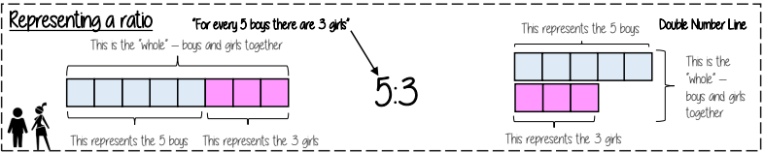
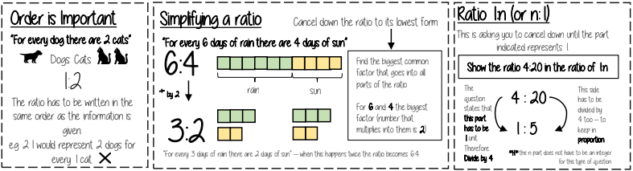
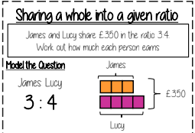
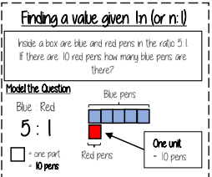
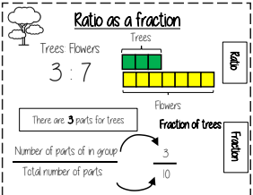
Maths: Ratio and Scale
K
Key Terms
Key Concepts
Ratio: a statement of how two numbers compare
Equal Parts: all parts in the same proportion, or a whole shared equally
Proportion: a statement that links two ratios
Order: to place a number in a determined sequence
Part: a section of a whole
Equivalent: of equal value
Factors: integers that multiply together to get the original value
Scale: the comparison of something drawn to its actual size.
Resilience, Excellence, Respect

Slide 4
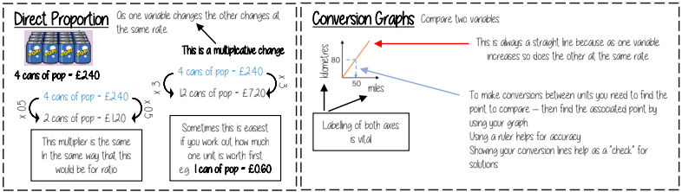
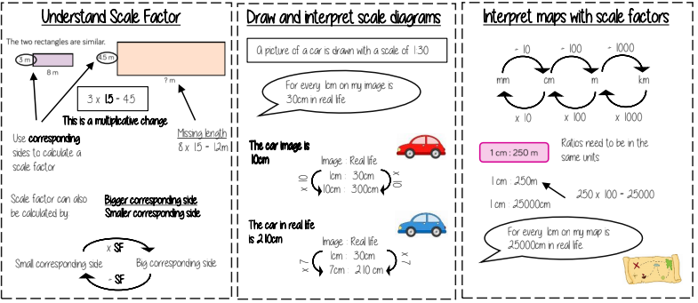
Maths: Multiplicative Change
K
Key Terms
Key Concepts
Proportion: a statement that links two ratios
Variable: a part that the value can be changed
Axes: horizontal and vertical lines that a graph is plotted around
Approximation: an estimate for a value
Scale Factor: the multiple that increases/ decreases a shape in size
Currency: the system of money used in a particular country
Conversion: the process of changing one variable to another
Scale: the comparison of something drawn to its actual size.
Resilience, Excellence, Respect

Slide 5
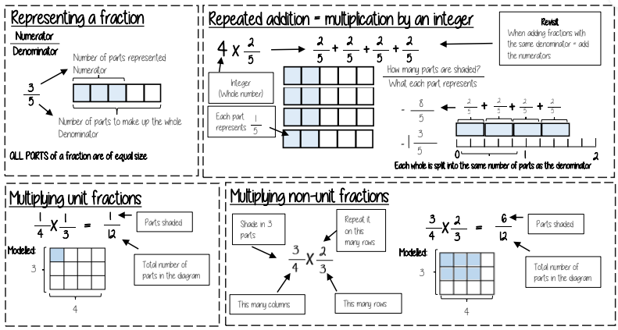
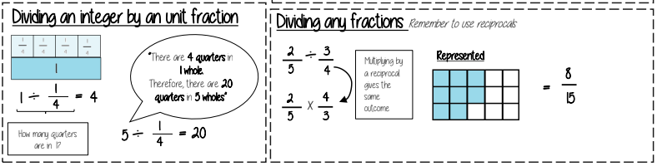
Maths: Multiplying and Dividing Fractions
K
Key Terms
Key Concepts
Numerator: the number above the line on a fraction. The top number. Represents how many parts are taken
Denominator: the number below the line on a fraction. The number represent the total number of parts.
Whole: a positive number including zero without any decimal or fractional parts.
Commutative: an operation is commutative if changing the order does not change the result.
Unit Fraction: a fraction where the numerator is one and denominator a positive integer.
Non-unit Fraction: a fraction where the numerator is larger than one.
Dividend: the amount you want to divide up.
Resilience, Excellence, Respect

Slide 6
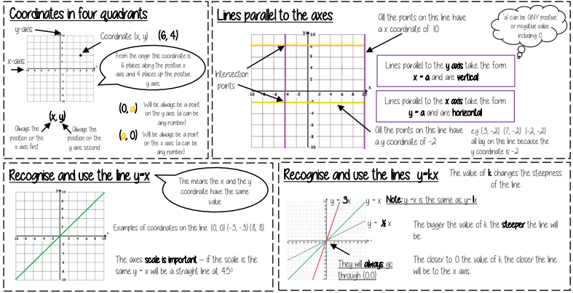
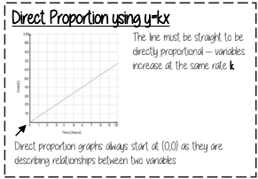
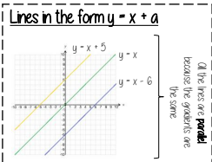
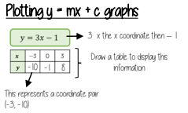
Maths: Working in the Cartesian plane
K
Key Terms
Key Concepts
Quadrant: four quarters of the coordinate plane.
Coordinate: a set of values that show an exact position.
Horizontal: a straight line from left to right (parallel to the x axis)
Vertical: a straight line from top to bottom (parallel to the y axis)
Origin: (0,0) on a graph. The point the two axes cross
Parallel: Lines that never meet
Gradient: The steepness of a line
Intercept: Where lines cross
Resilience, Excellence, Respect

Slide 7
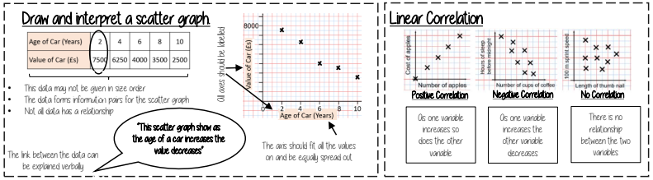
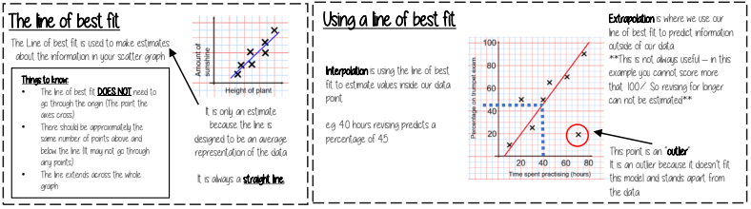
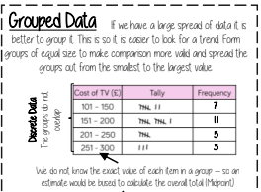
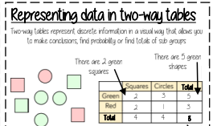
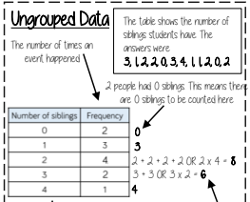
Maths: Representing Data
K
Key Terms
Key Concepts
Variable: a quantity that may change within the context of the problem.
Relationship: the link between two variables (items). E.g. Between sunny days and ice cream sales
Correlation: the mathematical definition for the type of relationship.
Line of best fit: a straight line on a graph that represents the data on a scatter graph.
Outlier: a point that lies outside the trend of graph.
Frequency: the number of times a particular data value occurs.
Resilience, Excellence, Respect

Slide 8
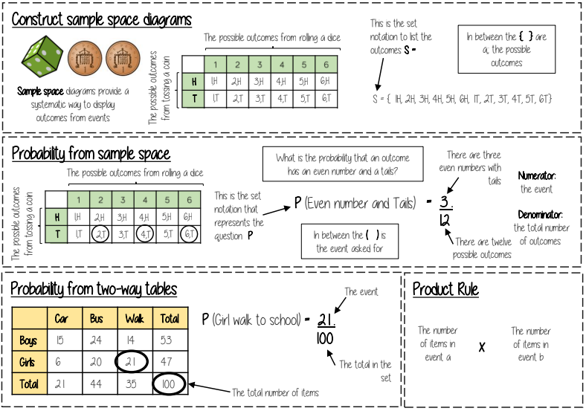
Maths: Tables and Probability
K
Key Terms
Key Concepts
Outcomes: the result of an event that depends on probability.
Probability: the chance that something will happen.
Set: a collection of objects.
Chance: the likelihood of a particular outcome.
Event: the outcome of a probability – a set of possible outcomes.
Biased: a built in error that makes all values wrong by a certain amount.
Union: Notation ‘∪’ meaning the set made by comparing the elements of two sets.
Resilience, Excellence, Respect

Slide 9
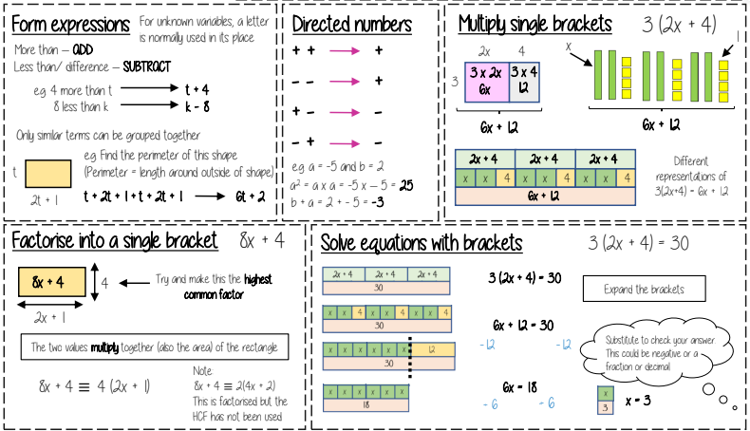
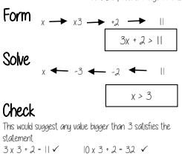

Maths: Brackets, Equations & Inequalities
K
Key Terms
Key Concepts
Simplify: grouping and combining similar terms
Substitute: replace a variable with a numerical value
Equivalent: something of equal value
Coefficient: a number used to multiply a variable
Product: multiply terms
Highest Common Factor (HCF): the biggest factor (or number that multiplies to give a term)
Inequality: an inequality compares who values showing if one is greater than, less than or equal to another
Resilience, Excellence, Respect

Slide 10
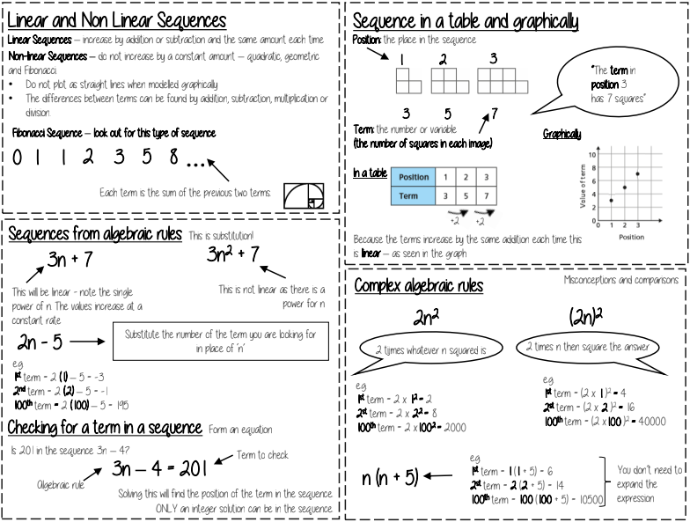
Maths: Sequences
K
Key Terms
Key Concepts
Sequence: items or numbers put in a pre-decided order
Term: a single number or variable
Linear: the difference between terms increases or decreases (+ or -) by a constant value each time
Non-linear: the difference between terms increases or decreases in different amounts, or by x or ÷
Arithmetic: a sequence where the difference between the terms is constant
Geometric: a sequence where each term is found by multiplying the previous one by a fixed non zero
number
Resilience, Excellence, Respect

Slide 11
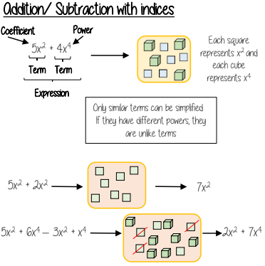
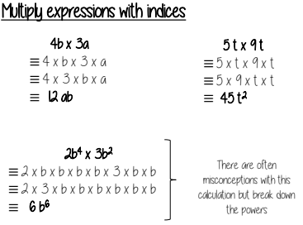
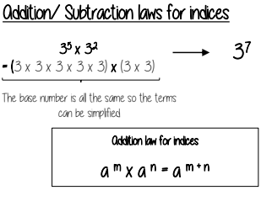
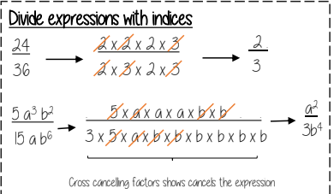
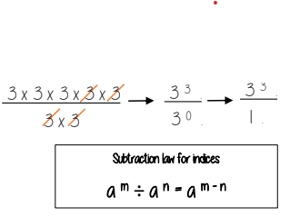
Maths: Indices
K
Key Terms
Key Concepts
Base: The number that gets multiplied by a power
Power: The exponent – or the number that tells you how many times to use the number in multiplication
Exponent: The power – or the number that tells you how many times to use the number in multiplication
Indices: The power or the exponent.
Coefficient: The number used to multiply a variable
Simplify: To reduce a power to its lowest term
Product: Multiply
Resilience, Excellence, Respect

Slide 12
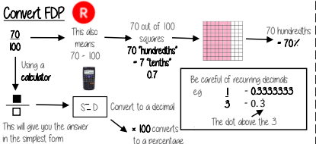
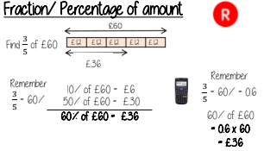
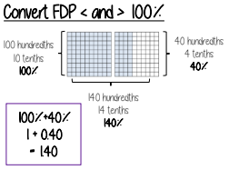
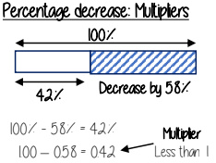
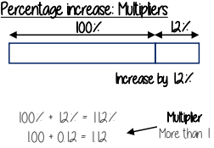
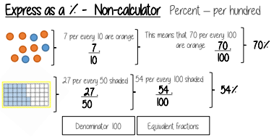
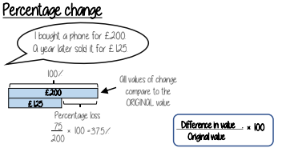
Maths: Fractions & Percentages
K
Key Terms
Key Concepts
Percent: parts per 100 – written using the % symbol.
Decimal: a number in our base 10 number system. Numbers to the right of the decimal place are called decimals.
Fraction: a fraction represents how many parts of a whole value you have.
Equivalent: of equal value.
Reduce: to make smaller in value.
Growth: to increase/ to grow.
Integer: whole number, can be positive, negative or zero.
Invest: use money with the goal of it increasing in value over time (usually in a bank).
Resilience, Excellence, Respect

Slide 13
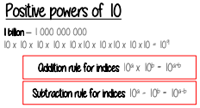
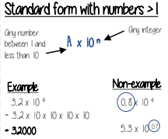
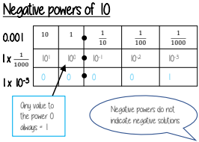
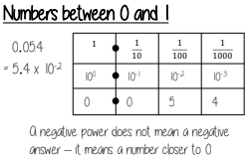
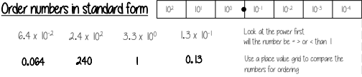
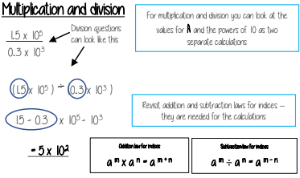
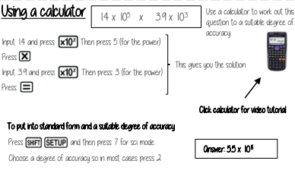
Maths: Standard Form
K
Key Terms
Key Concepts
Standard (index) Form: A system of writing very big or very small numbers
Commutative: an operation is commutative if changing the order does not change the result.
Base: The number that gets multiplied by a power
Power: The exponent – or the number that tells you how many times to use the number in multiplication
Exponent: The power – or the number that tells you how many times to use the number in multiplication
Indices: The power or the exponent.
Negative: A value below zero.
Resilience, Excellence, Respect

Slide 14
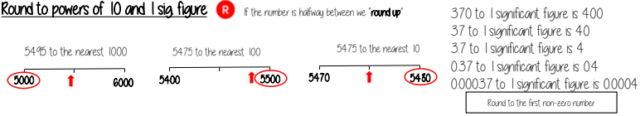
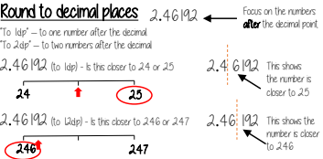
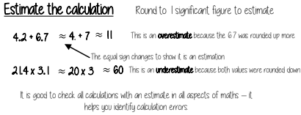
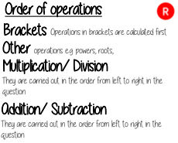
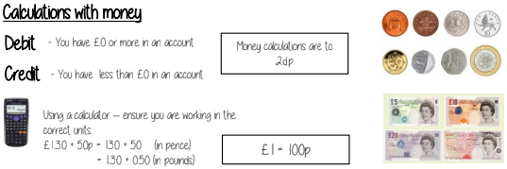
Maths: Number Sense
K
Key Terms
Key Concepts
Significant: Place value of importance
Round: Making a number simpler but keeping its value close to what it was.
Decimal: Place holders after the decimal point.
Overestimate: Rounding up – gives a solution higher than the actual value
Underestimate: Rounding down – gives a solution lower than the actual value.
Metric: A system of measurement.
Balance: The amount of money in a bank account
Deposit: Putting money into a bank account.
Resilience, Excellence, Respect

Slide 15
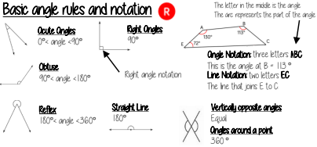
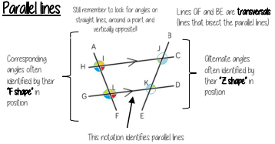
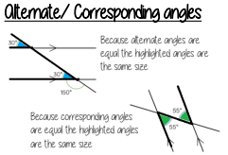
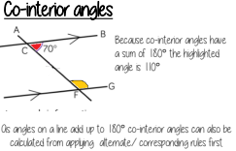



Maths: Angles in parallel lines and polygons
K
Key Terms
Key Concepts
Parallel: Straight lines that never meet
Angle: The figure formed by two straight lines meeting (measured in degrees)
Transversal: A line that cuts across two or more other (normally parallel) lines
Isosceles: Two equal size lines and equal size angles (in a triangle or trapezium)
Polygon: A 2D shape made with straight lines
Sum: Addition (total of all the interior angles added together)
Regular polygon: All the sides have equal length; all the interior angles have equal size.
Resilience, Excellence, Respect

Slide 16





Maths: Area of trapezia and Circles
K
Key Terms
Key Concepts
Congruent: The same
Area: Space inside a 2D object
Perimeter: Length around the outside of a 2D object
Pi (π): The ratio of a circle's circumference to its diameter.
Perpendicular: At an angle of 90° to a given surface
Formula: A mathematical relationship/ rule given in symbols. E.g. b x h = area of rectangle/ square
Infinity (∞): A number without a given ending (too great to count to the end of the number) – never ends
Sector: A part of the circle enclosed by two radii and an arc.
Resilience, Excellence, Respect

Slide 17




Maths: Line symmetry and reflection
K
Key Terms
Key Concepts
Mirror line: a line that passes through the center of a shape with a mirror image on either side of the line
Line of symmetry: same definition as the mirror line
Reflect: mapping of one object from one position to another of equal distance from a given line.
Vertex: a point where two or more-line segments meet.
Perpendicular: lines that cross at 90°
Horizontal: a straight line from left to right (parallel to the x axis)
Vertical: a straight line from top to bottom (parallel to the y axis)
Mirror line: a line that passes through the center of a shape with a mirror image on either side of the line
Line of symmetry: same definition as the mirror line
Reflect: mapping of one object from one position to another of equal distance from a given line.
Vertex: a point where two or more-line segments meet.
Perpendicular: lines that cross at 90°
Horizontal: a straight line from left to right (parallel to the x axis)
Vertical: a straight line from top to bottom (parallel to the y axis)
Resilience, Excellence, Respect

Slide 18





Maths: The data handling
K
Key Terms
Key Concepts
Spread: the distance/ how spread out/ variation of data
Average: a measure of central tendency – or the typical value of all the data together
Total: all the data added together
Frequency: the number of times the data values occur
Represent: something that show’s the value of another
Outlier: a value that stands apart from the data set
Consistent: a set of data that is similar and doesn’t change very much
Proportion: numerical relationship that compares two things
Resilience, Excellence, Respect

Slide 19



Science: Key Skills in Science
KS Line
Key Terms
Key Concepts
Diagrams/Formula/Word Map
Scientific method – Process of carrying out an investigation which isolates one variable to see its effect on another
Independent variable – The variable which you change
Dependent variable – the dependent which is measured]
Control variable - variables which are kept the same
Conclusion – a written summary that describes the results using data
Bar chart categorical data
Line graph – continuous data
Line of best fit – describes the pattern shown by a set of points
Resilience, Excellence, Respect

Slide 20





Science: Atoms, elements & compounds
K
Key Terms
Key Concepts
Diagrams/Formula/Word Map
Periodic table – table of elements in order of atomic number
Group – vertical columns of periodic table
Period – horizontal rows of periodic table
Atom – smallest piece of an element
Element – substance containing only one type of atom
Compound – 2 or more elements chemically joined together
Mixture – 2 or more elements and/or compounds not chemically joined together
Chemical reaction – process where 1/more substances are changed into others
Resilience, Excellence, Respect

Slide 21



Subject: Forces & Motion
K
Key Terms
Key Concepts
Diagrams/Formula/Word Map
Speed - Calculated using distance (metres) divided by time (seconds). Units of speed are metres per second Force - Can cause an object to be pushed, pulled, stretched, squashed, speed up and or slow down. Measured in Newtons (N). Resultant force - Overall force or force leftover when opposite forces act. Balanced forces - Forces that are equal and opposite. If forces are balanced then object is either stationary or moving at a constant velocity Unbalanced forces - Forces that are not equal and opposite. Results in acceleration – speeding up or slowing down
Resilience, Excellence, Respect

Slide 22


Science: Animals as Organisms
K
Key Terms
Key Concepts
Diagrams/Formula/Word Map
Skeletal System - The body system that consists of bones and joints. Skeleton - Consists of 206 bones in the human body. Functions of the skeleton - To support the body, to protect some of the vital organs of the body, to help the body move, to make blood cells. Muscular System - The body system that consists of muscle tissues and connective tissue. Muscles - Contract to produce movement. Respiratory System -Main organ = the lungs. Function = take in oxygen and remove carbon dioxide. Heart -Pump blood around the body
Resilience, Excellence, Respect

Slide 23




Science: Earth & resources
K
Key Terms
Key Concepts
Diagrams/Formula/Word Map
Crust - The thin, rocky outer layer of the Earth. Mantle - The thickest layer of the Earth. Found under the crust. Outer Core - The layer of the Earth in between the mantle and the inner core. Inner Core - Made of solid iron. The centre layer of the Earth, Igneous - Type of rock formed from cooling lava or magma Sedimentary - Type of rock formed from layers of sediment Metamorphic - Type of rock formed when sedimentary rock is under pressure and heat. Lava - Molten rock at the surface of a volcano. Magma - Molten rock under the surface of the earth.
Resilience, Excellence, Respect

Slide 24




Science: EM spectrum
K
Key Terms
Key Concepts
Waves - Transfer energy from one place to another Transverse waves - Vibrations are perpendicular to the direction in which the waves transfer energy. Longitudinal waves - Vibrations are parallel to the direction in which the waves are travelling. Amplitude - The height of the wave crest or the depth of the wave trough. The bigger the amplitude, the more energy the waves carry i.e. louder the sound. Wavelength - Distance between one wave crest to another. Frequency - The number of wave crests passing a fixed point every second. Measured in hertz (Hz)
Resilience, Excellence, Respect

Slide 25


Science: Inheritance & evolution
K
Key Terms
Key Concepts
Diagrams/Formula/Word Map
Adaptation: A characteristic that allows an organism to survive and reproduce in its habitat.
Community: Two or more populations of organisms in the same habitat.
Competition: Where organisms need a resource that has a limited supply.
DNA The molecule that contains all the genetic information (code) for each organism.
Ecosystem Interaction between a community of living organisms and their environment. An ecosystem is two or more populations of organisms (usually many more) in their environment.
Resilience, Excellence, Respect

Slide 26


Science: Electromagnetism
K
Key Terms
Key Concepts
Diagrams/Formula/Word Map
Series circuit - circuit which forms one single loop Parallel circuit - circuit which forms branches Electrical current - The rate of flow of charge/electrons. (I) I = Q/t Magnet - metal object with a magnetic field, and north and south poles. Magnetic Field -The area around a magnet that interacts with other magnetic objects. Magnetic metals Iron, Steel, Cobalt, Nickel Compass - A direction pointing device that consists of a mim bar magnet. Electromagnet Consists of wire wound into a coil around metal. It acts like a magnet when switched on.
Resilience, Excellence, Respect

Slide 27




Science: Reactions of metals
K
Key Terms
Key Concepts
Diagrams/Formula/Word Map
Metals and oxygen - Metal + oxygen 🡪 metal oxide - copper + oxygen 🡪 copper oxide Metals and water - Metal + water 🡪 metal salt + hydrogen Rust - Product of reaction between iron, oxygen and water Group 1 metals (Alkali metals) - Group of very reactive metals that react with water to form alkali solutions (hydroxides). Metals and acids - Metal + acid 🡪 metal salt + hydrogen Eg. Calcium + hydrochloric acid 🡪 calcium chloride + hydrogen Reactivity series - List of elements in order of reactivity Displacement reaction - Reaction where most reactive metal displaces least reactive metal.
The reactivity series
A reactivity series of metals can be created using the observations of their reactions with oxygen, water and acid.
.The metals which show the fastest and most violent reactions are the most reactive.Those which show no visible change are the least reactive. In the reactivity series, the metals are in order of reactivity, with the most reactive metals at the top.
Displacement reactions are chemical reactions which involve a metal and a compound containing a different metal. These compounds containing metals and non-metals are called salts. For example, iron (a metal) reacts with copper sulfate (a salt containing copper).
iron oxide + aluminium → iron + aluminium oxide
Resilience, Excellence, Respect

Slide 28



Science: Plants
K
Key Terms
Key Concepts
Diagrams/Formula/Word Map
Chloroplast - A plant organelle that contains a green pigment called chlorophyll. Where photosynthesis takes place. Cell Wall - The outside layer of a plant cell. Strengthens the cell. Vacuole - Filled with cell sap to keep the cell turgid Xylem - Plant tissue responsible for the transport of water and minerals. Phloem - Plant tissue responsible for the transport of sugars. Stomata - Tiny openings or pores in plant tissue that allow for gas exchange Waxy Layer - The layer on the outside of a leaf that protects it from the outside world. Epidermal tissues -Part of the leaf that is a layer of cells covering the top and bottom of the leaf. Palisade mesophyll - Part of the leaf that is made up of regularly shaped cells which contain many chloroplasts
Resilience, Excellence, Respect

Slide 29



Science: Work, power & energy
K
Key Terms
Key Concepts
Diagrams/Formula/Word Map
Energy Store - A means by which an object stores energy. Energy transfer - Energy moving from one store to another. Elastic potential energy - Anything that has been stretched or compressed. Eg: a spring. Chemical energy - Energy stored that can be released. Eg: food or fuel. Gravitational potential energy (G.P.E) - Anything that has a mass and is in its gravitational field energy store. Kinetic energy - Energy of a moving object.
The gravitational potential energy of an object raised above the Earth’s surface can be calculated using the equation:
gravitational potential energy = mass x gravitational field strength x vertical height raised
gravitational potential energy = mgh.
The kinetic energy of a moving object can be calculated using the equation:
Kinetic energy = 0.5 x mass x (speed)²
Kinetic energy = 0.5mv²
Power is the amount of energy transferred in one second or the amount of work done in one second.
Power is measured in watts (W) so 1 W = 1 joule per second (1 W = 1 J/s).
The efficiency of a device is a measure of how much of the input energy appears as useful output energy.
The more energy a device wastes, the less efficient it is.
Useful output energy refers to the useful energy in J (joules) that is transferred by the device
Input energy refers to the total energy in J supplied to a device
The equation used to calculate the work done is:
work done = force × distance
Resilience, Excellence, Respect

Slide 30



Science: Reaction of Acids
K
Key Terms
Key Concepts
Diagrams/Formula/Word Map
Acid
Solution with a pH of 1-6 (red-yellow with Universal indicator)
Alkali
Solution with a pH of 8-14 (blue to purple with Universal indicator)
Neutral
Solution with a pH of 7(green with Universal indicator)
Resilience, Excellence, Respect

Slide 31
History: How did the Reformation affect Britain?
K
Key Terms
Key Concepts
Diagrams/Formula/Word Map
dddd
Why did the Reformation happen?
Henry VIII wanted an annulment from Catherine of Aragon.
The Pope refused.
Henry broke with Rome and became Head of the Church of England.
How did Elizabeth I deal with religion?
Elizabeth I was Protestant.
Her Religious Settlement (1559) aimed to unite Catholics and Protestants.
England remained Protestant, although religious tensions continued.
Why did the Spanish Armada fail (1588)?
English ships were faster and more manoeuvrable.
English fire ships disrupted the Spanish formation.
Strong winds and storms damaged Spanish ships ("Protestant Wind").
The Spanish plan to join forces with an army in the Netherlands failed.
What were the consequences of the Reformation?
The monarch became head of the church.
Monasteries were closed and their wealth taken by the Crown.
England became a Protestant nation.
Rivalry with Catholic Spain increased.
Religious change shaped British politics and identity for centuries.
REFORMATION
│
┌──────────────────┼──────────────────┐
HENRY VIII CHURCH OF ENGLAND MONASTERIES
BREAKS WITH CLOSED
ROME
│
▼
└────────► PROTESTANT ENGLAND
│
▼
ELIZABETH I
│
RELIGIOUS SETTLEMENT (1559)
│
▼
CONFLICT WITH SPAIN
│
▼
SPANISH ARMADA (1588)
│
┌──────────────┼──────────────┐
English ships Fire ships Storms
│
▼
ENGLISH VICTORY
│
▼
STRONGER PROTESTANT ENGLAND
Reformation: A movement in the 1500s that challenged the Catholic Church
and led to Protestant churches.
Catholic A Christian who follows the authority of the Pope and the Roman Catholic Church.
Protestant A Christian who belongs to churches that broke away from the Catholic Church.
Pope Leader of the Roman Catholic Church.
Henry VIII: King of England who broke from Rome and created the Church of England.
Church of England: The national church established by Henry VIII.
Dissolution of the monasteries: Closure of monasteries by Henry VIII between 1536–1541.
Elizabeth I Protestant Queen of England (1558–1603) who restored stability after religious conflict.
Religious Settlement: Elizabeth's compromise that made the Church of England Protestant while keeping some traditional features.
Spanish Armada: A fleet sent by Spain in 1588 to invade England and restore Catholicism.
Resilience, Excellence, Respect

Slide 32
History: Why did Parliament kill the king?
K
Key Terms
Key Concepts
Diagrams/Formula/Word Map
English Civil War: A series of conflicts (1642–1651) between the King and Parliament.
Charles I: King of England whose actions led to conflict with Parliament.
Parliament: The group that helped make laws and approve taxes.
Royalists: Supporters of King Charles I ("Cavaliers").
Parliamentarians: Supporters of Parliament ("Roundheads").
Divine Right: The belief that kings received their authority directly from God.
New Model Army: Parliament's professional army, created in 1645.
Oliver Cromwell: Parliamentarian leader and key commander of the New Model Army.
Trial of Charles I The court case in 1649 where Charles I was accused of treason.
Execution: The carrying out of a death sentence; Charles I was executed in 1649.
CHARLES I
│
┌───────────────┼───────────────┐
DIVINE RIGHT TAXES WITHOUT RELIGIOUS
OF KINGS PARLIAMENT DISPUTES
│
└───────────────┴───────────────┘
│
▼
CIVIL WAR (1642)
│
┌───────────────┼───────────────┐
│ │
ROYALISTS PARLIAMENT
(Support King) (Roundheads)
│
▼
NEW MODEL ARMY
│
▼
VICTORY
│
▼
TRIAL OF CHARLES I
│
▼
EXECUTION (1649)
│
▼
COMMONWEALTH
dddd
Why did the Civil War begin?
Charles I believed in the Divine Right of Kings.
He ruled without Parliament for 11 years (1629–1640).
He raised taxes without Parliament's approval.
Arguments over religion and power increased tensions.
Why did Parliament win?
Parliament controlled important towns and resources.
The New Model Army was well-trained and disciplined.
Oliver Cromwell became a successful military leader.
Key victories such as the Battle of Naseby (1645) weakened the King.
Why was Charles I executed?
Many MPs believed Charles could not be trusted.
Charles continued to negotiate and seek support after being defeated.
Parliament accused him of treason against his own people.
He was found guilty and executed on 30 January 1649.
What were the consequences?
England became a republic (Commonwealth).
The monarchy was abolished temporarily.
Oliver Cromwell became the most powerful figure in England.
The execution showed that even a king could be held accountable.
Resilience, Excellence, Respect

Slide 33
HIstory: Who benefitted from the Transatlantic Slave Trade?
K
Key Terms
Key Concepts
Diagrams/Formula/Word Map
dddd
How did the Transatlantic Slave Trade work?
European merchants traded goods in Africa.
African captives were sold into slavery and transported across the Atlantic.
Enslaved people worked on plantations in the Americas.
Plantation products such as sugar and tobacco were shipped to Europe.
Who benefitted?
European merchants made large profits.
Plantation owners gained wealth from forced labour.
Port cities such as Liverpool and Bristol grew rich through trade.
Some governments collected taxes from trade and imports.
Who suffered?
Millions of Africans were enslaved and deprived of their freedom.
Families and communities were separated.
Many people died during capture, transportation or enslavement.
African societies experienced long-term social and economic damage.
What ended the trade?
Abolition campaigners highlighted the cruelty of slavery.
Formerly enslaved people shared their experiences.
Parliament passed the Slave Trade Act in 1807.
Slavery itself was abolished across most of the British Empire in 1833.
TRANSATLANTIC SLAVE TRADE
│
┌─────────────────┼───────────
EUROPE AFRICA AMERICAS
│ Captives forced Plantation
│ into slavery labour
│
└─────────────────┼─────────────────┘
│
MIDDLE PASSAGE
│
▼
PROFITS FOR MERCHANTS
AND PLANTATION OWNERS
│
▼
SUFFERING FOR ENSLAVED
AFRICANS
│
▼
ABOLITION MOVEMENT
│
▼
SLAVE TRADE ACT 1807
Transatlantic slave trade: The forced transportation of millions of Africans across the Atlantic Ocean to the Americas.
Enslaved person: A person treated as property and forced to work without freedom.
Plantation: A large farm growing crops such as sugar, tobacco or cotton.
Triangle Trade: The trade route linking Europe, Africa and the Americas.
Middle Passage: The journey enslaved Africans were forced to make across the Atlantic.
Merchant: A person who buys and sells goods for profit.
Profit: Money gained from a business or trade.
Abolition: The ending of slavery and the slave trade
Olaudah Equiano: Formerly enslaved writer whose autobiography helps campaign against slavery.
Slave Trade Act (1807) Law that ended Britain's involvement in the slave trade.
Resilience, Excellence, Respect

Slide 34
History: How did the Industrial revolution change Britain?
K
Key Terms
Key Concepts
Diagrams/Formula/Word Map
dddd
Why did the Industrial Revolution happen?
Britain had large supplies of coal and iron.
New inventions increased production.
Growing trade created demand for goods.
Improvements in farming freed workers for factory jobs.
How did people's lives change?
Many people moved from villages to towns and cities.
Factory work replaced many traditional jobs.
New transport links made travel and trade faster.
Goods became cheaper and more widely available.
What problems did it create?
Overcrowded cities with poor housing.
Pollution from factories and coal.
Dangerous working conditions.
Child labour was common.
What were the consequences?
Britain became the world's leading industrial power.
Cities expanded rapidly.
Living standards improved for some people over time.
New laws gradually improved working and living conditions.
INDUSTRIAL REVOLUTION
│
┌───────────────┼──────────────
COAL & IRON NEW MACHINES FACTORIES
└───────────────┴───────────────┘
│
▼
MORE GOODS PRODUCED
│
▼
URBANISATION
(Growth of Towns & Cities)
│
┌───────────────┼──────────────
JOBS POLLUTION CHILD LABOUR
└───────────────┴───────────────┘
│
▼
MODERN INDUSTRIAL BRITAIN
Industrial Revolution: A period of rapid change (c.1750–1900) when Britain moved from farming to industry and manufacturing.
Factory: A building where goods are made using machines.
Urbanisation: The growth of towns and cities as people moved from the countryside.
Steam Engine: A machine powered by steam that transformed industry and transport.
Textile Industry: The production of cloth and clothing.
Coal: A fuel that powered factories, steam engines and homes.
Child Labour: Children working in factories, mines and workshops, often in dangerous conditions.
Working Class: People who earned wages through manual labour.
Public Health: Measures taken to improve people's health and living conditions.
Railway: A transport system using trains running on tracks.
Resilience, Excellence, Respect

Slide 35
History: Who benefitted from the British Empire
K
Key Terms
Key Concepts
Diagrams/Formula/Word Map
dddd
BRITISH EMPIRE
│
┌───────────────┼───────────────┐
TRADE RESOURCES POWER
└───────────────┼───────────────┘
│
▼
WEALTH FOR BRITAIN
│
┌───────────────┼───────────────┐
MERCHANTS INDUSTRIES GOVERNMENT
│
▼
COLONISED PEOPLES
│
┌───────────────┼───────────────┐
OPPORTUNITIES EXPLOITATION RESISTANCE
│
▼
INDEPENDENCE MOVEMENTS
British Empire: The collection of territories controlled by Britain around the world.
Colony: A country or territory ruled by another country.
Imperialism: Extending a country’s power and influence over other lands.
Trade: The buying and selling of goods between countries.
East India Company: A powerful British trading company that expanded British influence in India
Resources: Valuable materials such as cotton, tea, rubber and minerals.
Migration: The movement of people from one place to another.
Independence: Freedom from foreign rule.
Commonwealth: An association of independent countries, many formerly part of the British Empire.
Exploitation: Using people or resources unfairly for profit.
Why did Britain build an Empire?
To gain wealth through trade.
To access valuable resources and raw materials.
To increase Britain's power and influence.
To compete with other European empires.
Who benefitted?
British merchants and businesses made profits.
Britain gained resources and new markets.
Some settlers and local elites gained wealth and opportunities.
British cities and ports grew through global trade.
Who suffered?
Many colonised peoples lost control over their land and government.
Resources were often taken for Britain's benefit.
Some communities faced exploitation and discrimination.
Resistance and conflict occurred across the Empire.
What were the consequences?
Britain became one of the most powerful countries in the world.
Global trade and migration increased.
English language and British institutions spread.
Many colonies later fought for and gained independence.
Resilience, Excellence, Respect

Slide 36
History: How did women in Britain gain the right to vote?
K
Key Terms
Key Concepts
Diagrams/Formula/Word Map
dddd
Why did women want the vote?
Women had to obey laws but could not help choose lawmakers.
Many believed voting was a basic democratic right.
Women wanted a greater say in issues affecting their lives.
How did women campaign?
Suffragists used petitions, meetings and peaceful protests.
Suffragettes used more direct and militant methods to attract attention.
Campaigners worked for decades to persuade Parliament to change the law.
What role did the First World War play?
During the war (1914–1918), many women worked in factories, transport and hospitals.
Their contribution challenged traditional ideas about women's roles.
Public attitudes towards women began to change.
How did women gain the vote?
In 1918, some women over 30 gained the right to vote.
In 1928, women gained equal voting rights with men.
Britain became a more democratic society
WOMEN'S SUFFRAGE
│
┌──────────────┼──────────────┐
SUFFRAGISTS SUFFRAGETTES CAMPAIGNS
(Peaceful) (Militant) FOR VOTES
└──────────────┼──────────────┘
│
▼
PRESSURE ON PARLIAMENT
│
▼
FIRST WORLD WAR
│
▼
CHANGING ATTITUDES TO WOMEN
│
▼
REPRESENTATION OF THE PEOPLE ACT
(1918)
│
▼
EQUAL FRANCHISE ACT (1928)
│
▼
WOMEN GAIN THE VOTE
Suffrage: The right to vote in political elections.
Suffragist: A campaigner who used peaceful methods to win votes for women.
Suffragette: A member of a more militant campaign group for women's voting rights.
Women’s Social and Political Union (WSPU) The suffragette organisation founded by Emmeline Pankhurst in 1903.
National Union of Women’s Suffrage Societies (NUWSS): The main suffragist organisation led by Millicent Fawcett.
Emmeline Pankhurst: Leader of the WSPU and a key figure in the campaign for women's votes.
Millicent Fawcett: Leader of the NUWSS who campaigned through peaceful protest.
Militancy: The use of direct action, such as demonstrations, window-smashing and protests.
Representation of the People Act (1918): Law that gave some women over 30 the right to vote.
Resilience, Excellence, Respect

Slide 37


Geography: How do rivers shape our world?
K
Key Terms
Key Concepts
Diagrams/Formula/Word Map
Source: The place where a river begins, usually in highland areas.
Mouth: The palace where a river ends, flowing into the sea, lake, or another river.
Tributary: A smaller river or stream that joins a larger river.
Confluence: The point where two rivers or streams meet.
Watershed: The high land that separates one river basin from another.
Drainage Basin: The area of land drained by a river and its tributaries.
Erosion: The wearing away of rock and soil by the river.
Transportation: The movement of sediment by the river.
Deposition: The dropping of sediment when the river loses energy.
Meander: A winding bend or curve in a river.
How do river shape the landscape?
Rivers erode, transport and deposit rock and sediment.
These processes create landforms such as waterfalls, meanders and floodplains.
Why do rivers change from source to mouth?
Rivers become wider, deeper and carry more water downstream
Different landforms are found in the upper, middle and lower course
How do fluvial processes work together?
Erosion wears away the river channel and banks.
Transportation moves sediment and deposition drops it when the river loses energy.
How do rivers create opportunities and challenges?
Rivers provide water, transport, energy and recreation.
Flooding can damage homes, infrastructure and farmland.
dddd
Resilience, Excellence, Respect

Slide 38


Geography: Why is food insecurity a global challenge?
K
Key Terms
Key Concepts
Diagrams/Formula/Word Map
dddd
Food security: Having reliable access to enough safe, nutritious food.
Food insecurity: When people lack enough food for a healthy life.
Famine: An extreme shortage of food affecting many people.
Undernutrition: A lack of enough energy and nutrients from food.
Drought: A long period of very low rainfall.
Food miles: The distance food travels from producer to consumer.
Subsistence farming: Farming to produce food for a farmer’s own needs.
Commercial farming: Farming to produce food for sale and profit.
Sustainable agriculture: Farming that protects resources for the future.
Food waste: Food that is thrown away instead of being eaten.
Why is food important?
Food provides the energy and nutrients needed for healthy growth and life.
A reliable food supply supports healthy people and thriving communities
What causes famine?
Natural hazards such as drought can reduce food production
Conflict, poverty and climate change can limit access to food
How does farming affect food supply?
Different types of farming produce food in different ways
Sustainable farming helps protect resources while producing food.
How can food resources be managed sustainably?
Reducing food waste and improving farming increases food security
Buying local and seasonal food can reduce environmental impacts.
Resilience, Excellence, Respect

Slide 39


Geography: Can the world meet its energy needs sustainably?
K
Key Terms
Key Concepts
Diagrams/Formula/Word Map
Energy: The power used to heat, light and move things.
Energy resource: A source used to produce energy.
Fossil fuel: A non-renewable fuel such as coal, oil or gas.
Renewable energy: Energy from sources that can be naturally replaced
Non-renewable energy: Energy from sources that will eventually run out
Solar energy: Energy that is produced from sunlight.
Wind energy: Energy generated by moving air.
Hydroelectric Power (HEP): Electricity generated by flowing water.
Carbon emissions: Greenhouse gases released into the atmosphere.
Sustainability: Using resources without harming future generations.
dddd
Why do we need energy?
Energy is needed for heating, transport, electricity and industry.
Reliable energy supplies support economic development and quality of life.
Where does our energy come from?
Energy comes from renewable and non-renewable resources.
Different countries use different energy sources depending on their resources.
What are the impacts of different energy sources?
Fossil fuels release carbon emissions and contribute to climate change.
Renewable energy produces cleaner electricity but can have local environmental impacts.
How can energy be used more sustainably?
Using more renewable energy reduces reliance on fossil fuels.
Improving energy efficiency helps rescue energy use and carbon emissions.
Resilience, Excellence, Respect

Slide 40


Geography: How is our climate changing?
K
Key Terms
Key Concepts
Diagrams/Formula/Word Map
Climate: The average weather of a place over many years.
Climate Change: Long-term changes in Earth’s climate.
Mitigation: Action taken to rescue climate change.
Global warming: The rise in Earth’s average temperature.
Greenhouse gas: A gas that traps heat in the atmosphere.
Greenhouse effect: The natural process of heat being trapped by greenhouse gases.
Carbon dioxide: a greenhouse gas released by burning fossil fuels.
Fossil fuels: Non-renewable fuels such as coal, oil and gas.
Renewable energy: Energy from sources that can be naturally replaced.
Carbon footprint: The greenhouse gases produced by a person or activity.
dddd
What is climate change?
Climate change is a long-term change in Earth's climate.
Global warming is causing average temperatures to rise.
What causes climate change?
Burning fossil fuels releases greenhouse gases.
These gases trap more heat in the atmosphere.
What are the impacts of climate change?
It increases the risk of extreme weather and rising sea levels
It affects people, wildlife and ecosystems around the world.
How can we tackle climate change?
Reduce greenhouse gas emissions by using renewable energy.
Protect forests and use energy more efficiently.
Resilience, Excellence, Respect

Slide 41

Geography: Where is the best place to plant a Giant Redwood tree?
K
Key Terms
Key Concepts
Diagrams/Formula/Word Map
dddd
Ecosystem: A community of living and non-living things interacting.
Habitat: The natural home of a plant or animal.
Biodiversity: The variety of living organisms in an area.
Food chain: A sequence showing how energy passes between organisms.
Environment: The surroundings in which organisms live.
Soil: The top layer of earth where plants grow.
Drainage: How easily water moves through soil.
Microclimate: The climate of a small local area.
Fieldwork: Collecting information outside the classroom.
Site suitability: How appropriate a location is for a specific purpose.
What is an ecosystem?
An ecosystem is made up of living and non-living things
These parts depend on each other to survive.
Why is biodiversity important?
Biodiversity helps ecosystems stay healthy and balanced
A greater variety of species makes ecosystems more resilient.
How do we choose a suitable site for a giant redwood tree?
We investigate soil, drainage and the microclimate.
The best site provides the conditions the tree needs to grow.
How does fieldwork help geographers?
Fieldwork collects first-hand data about a place.
It helps geographers make informed decisions using evidence.
Resilience, Excellence, Respect

Slide 42

Geography: How can the Middle East become more sustainable?
K
Key Terms
Key Concepts
Sustainability: Meeting today's needs without preventing future generations from meeting theirs.
Sustainable development: Development that balances people, the economy and the environment.
Water scarcity: A shortage of available fresh water.
Desalination: Removing salt from seawater to produce fresh water.
Renewable energy: Energy from sources that can be naturally replaced.
Fossil fuels: Non-renewable fuels such as coal, oil or gas.
Solar energy: Energy produced using sunlight.
Diversification: Developing new industries beyond oil and gas.
Urbanisation: The growth of towns and cities.
Conservation: Protecting and managing natural resources.
How can the Middle East reduce its reliance on oil?
Renewable energy provides cleaner sources of power.
Diversifying the economy creates new jobs and industries.
How can people make the Middle East more sustainable?
Use resources more efficiently and reduce waste.
Balance economic growth with protecting the environment.
dddd
Why is sustainability important in the Middle East?
The region has limited water and a hot, dry climate
Sustainable development protects resources for the future.
How can water be managed more sustainably?
Desalination and water recycling increase fresh water supplies.
Conserving water reduces demand and waste.
Resilience, Excellence, Respect

Slide 43








Spanish Year 8 Half Term 1
K
Key Vocabulary
Key Concepts
Grammar & Phonics
Singular
plural
porque es/ porque son
Resilience, Excellence, Respect

Slide 44









Spanish Year 8 Half Term 2
K
Key Vocabulary
Key Concepts
Grammar & Phonics
Resilience, Excellence, Respect

Slide 45








Spanish Year 8 Half Term 2
K
Key Vocabulary
Key Concepts
Grammar & Phonics
Resilience, Excellence, Respect

Slide 46













Spanish Year 8 Half Term 3
K
Key Vocabulary
Key Concepts
Grammar & Phonics
Resilience, Excellence, Respect

Slide 47












Spanish Year 8 Half Term 4
K
Key Vocabulary
Key Concepts
Grammar & Phonics
Resilience, Excellence, Respect

Slide 48









Spanish Year 8 Half Term 5
K
Key Vocabulary
Key Concepts
Grammar & Phonics
Resilience, Excellence, Respect

Slide 49










Spanish Year 8 Half Term 5
K
Key Vocabulary
Key Concepts
Grammar & Phonics
Resilience, Excellence, Respect

Slide 50

Computational Thinking - Year 8
Key Vocabulary
Key Concepts
Diagrams
Computational Thinking
Decomposition
Pattern Recognition
Abstraction
Algorithm Design
Pseudocode
Flowcharts
Iteration
Debugging
To understand that you can tackle big problems by breaking them down into smaller parts using Computational Thinking.
To understand the four parts of Computational Thinking; decomposition, pattern recognition, abstraction and algorithms.
To create your own solutions to problems using Computational Thinking.
To be able to construct a flowchart or write pseudocode to represent a set of instructions
To be able to fix errors within your algorithm.
Resilience, Excellence, Respect

Slide 51


Mobile App ( App for Good) - Year 8
Key Vocabulary
Key Concepts
Diagrams
Computational Thinking
Social Action
Prototyping
Algorithms
Programming (App Lab)
Problem Solving
Collaboration
Innovation
Self Assessment
Learn about technology for social action and modify an app to ensure it is accessible to others.
Work in teams to design and modify an app to link to 1 of the Sustainable Development Goals (SDGs) have been created by the United Nations (UN) in order to help everyone achieve a more sustainable future.
Develop their computational thinking skills and complete their prototype.
Work in their teams to complete their prototype before preparing and practicing a presentation of their work.
Present their app innovation to an audience/industry expert *, then evaluate their prototype and their learning.
Resilience, Excellence, Respect

Slide 52






Data Representation - Year 8
K
Key Vocabulary
Key Concepts
Diagrams
Binary Digits
Bytes
Communication
Decimal (Denary)
Gigabytes
Kilobytes
Length
Megabytes
Sequences
Binary Digits (bits): The smallest unit of data, which can only be a 0 or 1
Decimal (Denary): A number system that uses 10 digits (0 - 9), also known as the base 10 number system. It’s the number system we use every day
Bytes: A unit of data made up of 8 binary Digits (bits). It is used to store information in a computer, like a letter, number or symbol
Binary Digits (Bits)
Example of a Binary number
Binary Conversion Table
x2
x2
Resilience, Excellence, Respect

Slide 53






Computing Systems - Year 8
K
Key Vocabulary
Key Concepts
Diagrams/Formula/Word Map
Computer
Program
Processor
Storage
Execute
Operating System
Hardware
Boolean
Logic Gate
Truth Table
Analyse
Data Pattern
Data Cleaning
Data Bias
Data Pattern: A recurring trend, relationship, or structure found within a set of data
General Purpose Computer: Performs a wide range of tasks
Hardware: The physical components of a computer
Input & Output: Input - send data to a computer (keyboard, mouse) and Output- displays data from a computer (monitor, printer)
Logical Operators: Basic operations that manipulate true/false values: AND, OR, NOT
Operating System: Software that manages hardware resources and produces a user interface
Processor: the part of the computer that carries out instructions and makes decisions
Processor : the part of the computer that carries out instructions and makes decisions
Software: Programs that perform a specific task or function i.e. Social Media or Phone Call App
Logic Gates
Resilience, Excellence, Respect

Slide 54

Edublocks (Programming) - Year 8
K
Key Vocabulary
Key Concepts
Diagrams
Conditions
Float
Functions
Integer
Iteration
Selection
Sequence
String
User Input
Variables
Sequence: The order in which instructions are carried out, one after another
Selection: A decision making process in a program, where different actions happen based on a condition (using if, else)
Iteration/Loops: Repeating a set of instructions, either a certain number of times or until a condition is met (using for or while loops)
String: A sequence of letters, numbers or symbols treated as text (e.g. “Hello”)
Integer: A whole number with no decimal places (e.g. 5)
Float: A number that has a decimal point (e.g. 3.14)
Resilience, Excellence, Respect

Slide 55


Impact of Technology - Year 8
K
Key Vocabulary
Key Concepts
Diagrams
Artificial Intelligence
Bias
Deep Learning
Digital Footprint
Ethics
Information
Content & Contact
Machine Learning
Personal Information
Privacy
Respectful Communication
Robotics
Data: Raw facts and figures with no meaning on their own (e.g. 23, blue, yes)
Information: Data that has been processed or organised so it makes sense and has meaning (e.g. Age: 23, Eyes: Blue)
Personal Information: Details about a person that can be used to identify them, like their name, address or phone number
Artificial Intelligence: Computer systems that can do tasks normally needing human intelligence, like recognising speech or making decisions.
Machine Learning: A type of AI where computers learn from data and improve at tasks without being specifically programmed for them
Deep Learning: An advanced type of machine learning that uses ‘neural networks’ to solve complex problems, like facial recognition or translating languages
Resilience, Excellence, Respect

Slide 56







Year 8 Art
K
Key Vocabulary
Key Artists
Key Techniques / Materials
Lines = Line is the most basic visual element. Lines can be used to define shapes and figures, but also to indicate motion, emotion, and other elements
Texture = In a two-dimensional work of art, texture gives a visual sense of how an object depicted would feel in real life if touched
Two- Dimensional = Length and width but no depth. A drawing on a piece of paper.
Three Dimensional = Length, width and depth. A sculpture/object.
Composition = How elements are arranged in the painting or drawing.
Pattern - a motif which is repeated to create a pattern
Sara
Fanelli
Henri
Matisse
Alexander
Calder
Mark Making = Mark making describes the way artists produce different lines, dots, marks, patterns and textures
Collage = Collage describes the technique and the resulting work of art in which pieces of paper are arranged and stuck down
Watercolour
Sarah Graham
Resilience, Excellence, Respect

Slide 57




Year 8 3D Design
K
Key Vocabulary
Key Skills
Key Ideas
Design Brief analysis
Isometric drawing for box design
Investigate the various forms of construction using joints
Mark out joints using correct equipment
Learn the skill of Marquetry through accurate measuring and cutting
Evaluate the task, processes and outcome at each key stage of the project
Offer alternate ideas and reflect on the project identifying areas for improvement and development
Drawing
Marking out & measuring
Fabricating
Finishing
Looking closely: Using a design brief to develop a product
Use technical drawing: to develop design ideas
Construct: a wooden box
Investigate, analyse and choose appropriate construction method with accurate lid design using Marquetry in veneered wood
Critically evaluate: each process offering insight, demonstrate an appreciation for the task, process and outcome
Resilience, Excellence, Respect

Slide 58




Year 8 Visual Communication
K
Key Vocabulary
Key Artists
Key Ideas
DESIGN BRIEF = Using direction to inspire creative responses
PHOTOGRAPHY = Use of composition techniques and exploring colour
RULES OF COMPOSITION = is the type of arrangement of all the elements that make up the scene in a photograph.
ILLUSTRATION = how artwork can be integrated into designs both physically and digitally.
ANDY WARHOL
PRODUCT LABELING= using digital and physical illustration and graphic design techniques to meet a design brief
TYPOGRAPHY = Using knowledge of typography to apply to a product.
EDITING = Altering images once they have been taken both on computers and by hand
Resilience, Excellence, Respect

Slide 59

Year 8 Food Technology
K
Key Vocabulary
Key Skills
Key Ideas
Micronutrients are vitamins and minerals needed by the body in very small amounts.
Food poisoning -Food poisoning can occur as a result of eating too many bacteria that have been allowed to multiply. In food- for instance, if the food has not been handled or stored correctly.
To prevent the spread of bacteria, temperatures in the kitchen need to be kept to Health and Hygiene Standards. Otherwise bacteria will reach The Danger Zone which is 5- 65 degrees c. This is where bacteria multiply rapidly.
You can avoid getting food poisoning by making sure…
Cooking and reheating food properly
Washing hands with soap and water
Disinfecting surfaces with antibacterial spray
Not consuming out of date foods
Storing food correctly
Kneading - developing the gluten structure, creating the right texture, ensuring yeast and salt are evenly spread throughout the bake
Dicing- cutting food item into small blocks or dice
Resilience, Excellence, Respect

Slide 60

Drama: Mime
Resilience, Excellence, Respect

Slide 61

Drama: Physical Theatre
Resilience, Excellence, Respect

Slide 62

Drama: Street Theatre
Resilience, Excellence, Respect

Slide 63

Music: Blues
Resilience, Excellence, Respect

Slide 64

Music : Musicals
Resilience, Excellence, Respect

Slide 65

Music : Soundtracks
Resilience, Excellence, Respect

