Slide 1

COLCHESTER
ACADEMY
Year 7 Knowledge Organiser
2026-2027
Resilience, Excellence, Respect

Slide 2
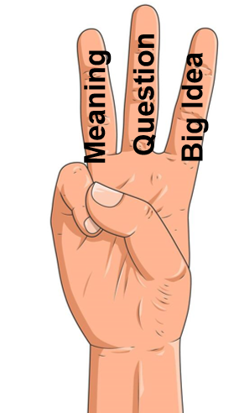
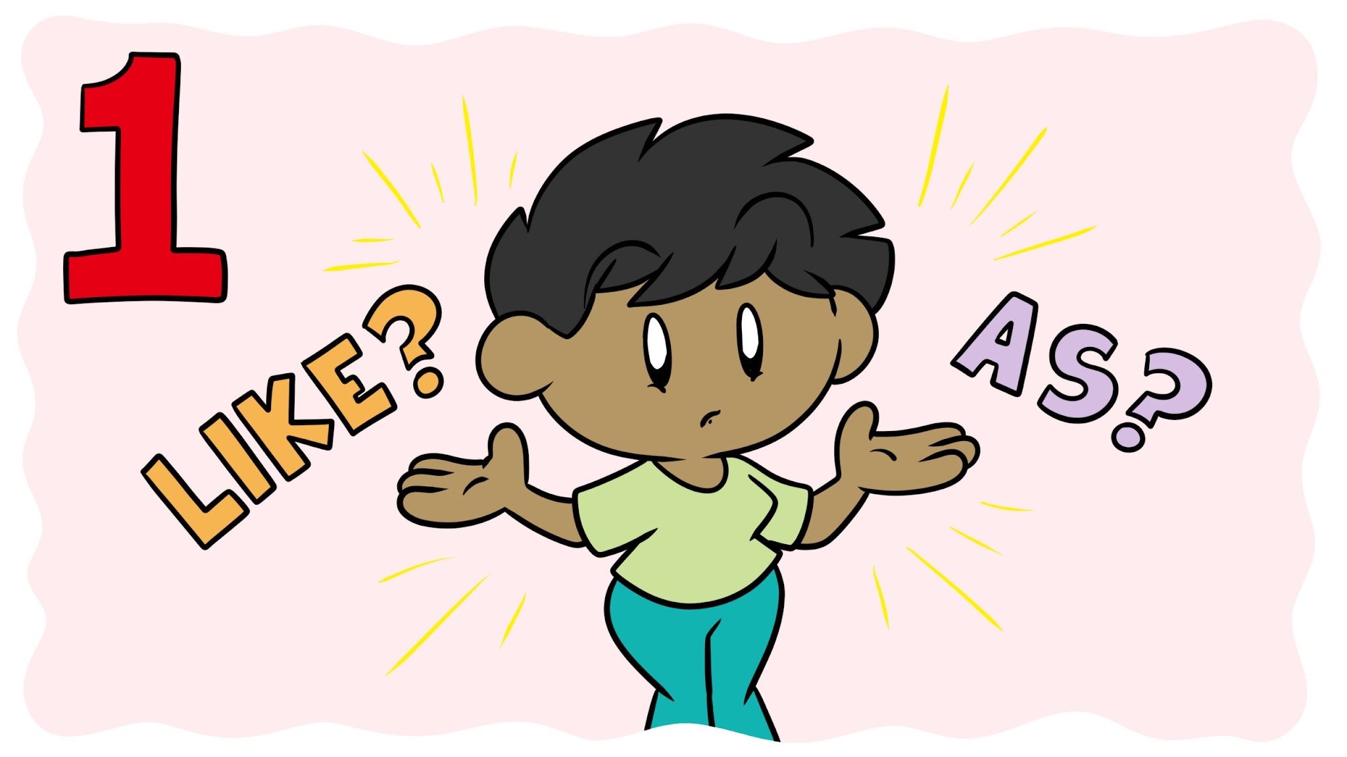
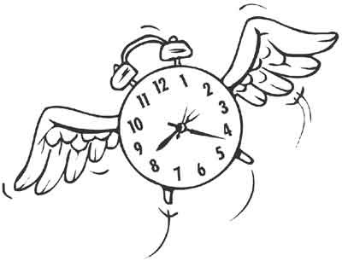






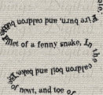
English: Unseen Poetry
K
Key Terms
Key Concepts
Poetic Techniques
Stanza – | A grouped set of lines in a poem, often separated by a space.
Line – | A single row of words in a poem.
Verse – | A line of poetry or a stanza.
Meter – | The rhythm of a poem, determined by the pattern of stressed and unstressed syllables.
Iambic Pentameter – | A line with ten syllables in an unstressed-stressed pattern.
Form and Structure
How a poem’s shape, layout, and pattern contribute to meaning.
Includes sonnets, free verse, haikus, ballads, etc.
Simile | Comparing one thing to another, normally using “like” or “as…as…”.
Metaphor | Comparing one thing to another in a non-literal way.
Personification | Giving an inanimate object/thing human characteristics.
Juxtaposition | Two contrasting (opposite) ideas or people or objects or moods within a text.
Repetition | Repeating words/ideas across a text.
Rhyme | When words sound the same, usually at the end of each line
Alliteration | Repetition of the same letter/sound of words either next to each other or close to each other.
Onomatopoeia | A word of which its name is also associated with its sound.
Caesura | The use of punctuation/pauses within a line of poetry/at the end of a line
Enjambment | The continuation of a sentence onto the next line without punctuation past a line/stanza.
Voice and Speaker
The identity or persona created in the poem — not always the poet.
First-person vs. third-person, and how that affects the poem’s tone and perspective.
Tone and Attitude
The poet’s or speaker’s emotional stance toward the subject (e.g., bitter, joyful, reflective).
Mood and Atmosphere
The emotional environment or feeling the poem creates for the reader.
Imagery and Sensory Language
Use of vivid, descriptive language that appeals to the senses.
Helps visualize the scene or emotion being conveyed.
Themes and Messages
Central ideas or messages explored in the poem.
Often involve universal topics like love, death, nature, war, identity, or time.
Resilience, Excellence, Respect

Slide 3


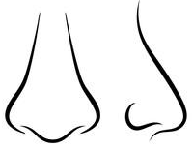









English: Oliver Twist
K
Key Terms
Key Concepts
Quotations
Workhouse
A place where the poor were sent to work in exchange for food and shelter. Often harsh and unpleasant.
Social Injustice
The novel exposes the harsh realities of poverty, child exploitation, and the failure of social systems like the Poor Laws and workhouses.
 | “The man who growled out these words.”
 | “Please sir, I want some more.”
 | “He was a snub-nosed, flat-browed, common-faced boy enough.”
 | “He wore a man's coat, which reached nearly to his heels.”
 | “With a toasting-fork in his hand, was a very old shrivelled Jew”
 | “Whose villainous-looking and repulsive face was obscured by a quantity of matted red hair.”
 | “Always look in an unfinished and incomplete state without a set of fetters to garnish them”
 | “A dirty belcher handkerchief round his neck”
 | “Two scowling eyes; one of which displayed various parti-coloured symptoms of having been recently damaged by a blow.”
 | “How about a game, Oliver?”
 | “Get up! Or I’ll strew your brains upon the grass.”
 | “Sikes, seizing the poker in one hand, and deliberately opening with the other a large clasp-knife”
Poverty
The state of being extremely poor. A central theme of the novel.
Class and Inequality
Dickens critiques the rigid Victorian class structure, showing how the poor are mistreated while the wealthy live in comfort.
The contrast between the rich and poor is central to understanding characters' motivations and opportunities.
Hypocrisy
Pretending to have morals or beliefs that one does not truly possess. Seen in some authority figures.
Nature vs. Nurture
Explores whether a person’s character is shaped more by their environment or their innate qualities.
Despite being raised in brutal conditions, Oliver remains kind and moral — a key argument against the idea that poverty breeds criminality.
Innocence
Lack of guilt or wrongdoing. Oliver symbolises innocence in a corrupt world.
Innocence and Corruption
Oliver represents innocence, while Fagin’s gang and Bill Sikes embody corruption.
Dickens uses this contrast to highlight the moral decay of society.
Morality
Knowing the difference between right and wrong. Many characters struggle with this.
Crime and Punishment
The novel examines the criminal underworld, particularly the manipulation of children into crime.
Raises questions about responsibility, justice, and redemption.
Resilience, Excellence, Respect

Slide 4
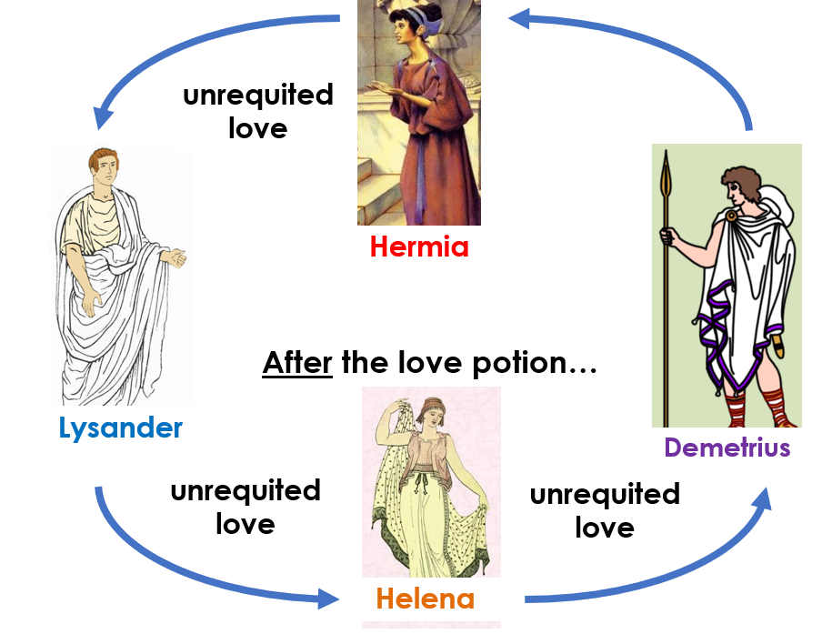

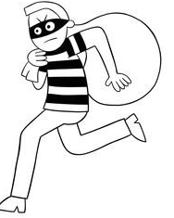






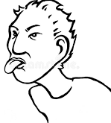




English: A Midsummer Night’s Dream
K
Key Terms
Key Concepts
Quotations
Comedy | A play with a happy ending, often involving misunderstandings and mistaken identities.
Patriarchy | a society controlled by men in which they use their power to their own advantage
Unrequited | Something which is not returned or reciprocated
Soliloquy | a speech in a play that the character speaks aloud to the audience, not to the other characters
Morality | a set of personal or social standards for good or bad behaviour and character
 | “The course of true love never did run smooth.”
 | “O me, you juggler, you canker-blossom, You thief of love!”
 | “To you your father should be as a god.”
 | “Before, milk-white, now purple with love's wound”
 | “For I am sick when I look on thee”
 | “Use me but as your spaniel,”
 | “My love for Hermia melted as the snow.”
 | “Who wouldn’t change a raven for a dove?”
 | “Wherefore was I to this keen mockery born?”
 | “Thou art as beautiful as thou art wise”
 | “The juice of it on sleeping eyelids laid/ Will make or man or woman madly dote/ upon the next live creature that it sees.”
 | “Not Hermia but Helena I love.”
 | “do I not in plainest truth/Tell you, I do not, nor I cannot love you?”
Love and Desire
The play explores different types of love: romantic, unrequited, irrational, and magical.
Love is shown as unpredictable, illogical, and often chaotic.
Shakespeare satirizes the idea that love follows reason or social rules
Reality vs. Illusion
The contrast between what is real and what is imagined is central. The magical forest represents a world where the usual rules don’t apply, blurring lines between dream and reality. The play ends with a suggestion that everything might have been a dream, emphasising its playful uncertainty.
Order and Chaos
The world of Athens (law, order, reason) vs. the forest (magic, mischief, emotion).
Chaos is caused by magic and mistaken identities, but it’s ultimately resolved, suggesting a return to harmony.
Resilience, Excellence, Respect

Slide 5
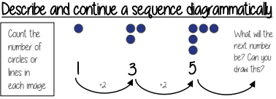
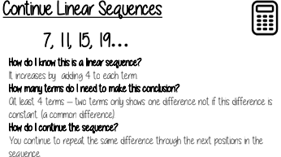
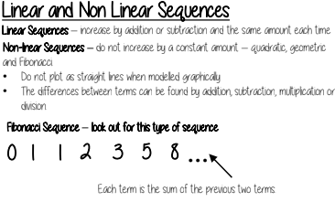
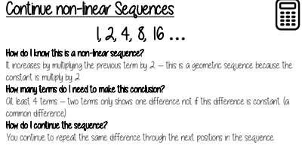
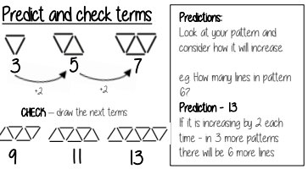
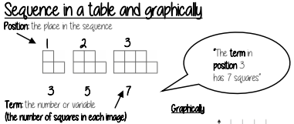
Maths: Sequences
K
Key Terms
Key Concepts
Diagrams/Formula/
Word Map
Sequence: items or numbers put in a pre-decided order
Term: a single number or variable
Position: the place something is located
Rule: instructions that relate two variables
Linear: the difference between terms increases or decreases by the same value each time
Non-linear: the difference between terms increases or decreases in different amounts
Difference: the gap between two terms
Arithmetic: a sequence where the difference between the terms is constant
Geometric: a sequence where each term is found by multiplying the previous one by a fixed non zero number
Resilience, Excellence, Respect

Slide 6
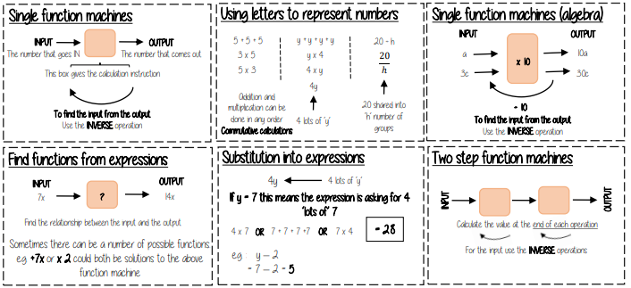
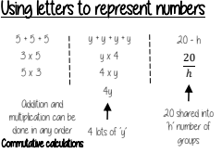
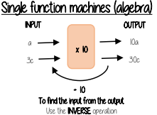
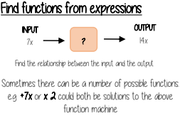
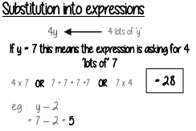
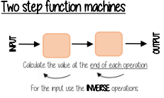
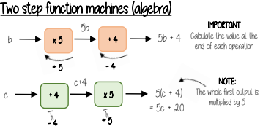
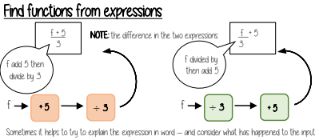
Maths: Algebraic Notion
K
Key Terms
Key Concepts
Function: a relationship that instructs how to get from an input to an output.
Input: the number/ symbol put into a function.
Output: the number/ expression that comes out of a function.
Operation: a mathematical process Inverse: the operation that undoes what was done by the previous operation. (The opposite operation)
Commutative: the order of the operations do not matter. Substitute: replace one variable with a number or new variable.
Expression: a maths sentence with a minimum of two numbers and at least one math operation (no equals sign)
Evaluate: work out Linear: the difference between terms increases or decreases by the same value each time
Function: a relationship that instructs how to get from an input to an output.
Input: the number/ symbol put into a function.
Output: the number/ expression that comes out of a function.
Operation: a mathematical process
Inverse: the operation that undoes what was done by the previous operation. (The opposite operation)
Commutative: the order of the operations do not matter.
Substitute: replace one variable with a number or new variable.
Expression: a maths sentence with a minimum of two numbers and at least one math operation (no equals sign)
Evaluate: work out
Linear: the difference between terms increases or decreases by the same value each time
Resilience, Excellence, Respect

Slide 7
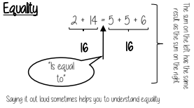
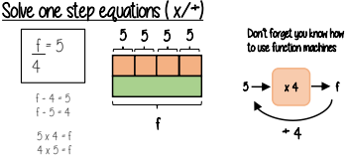
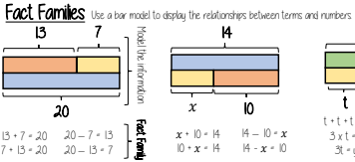
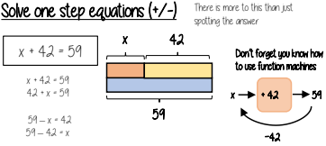
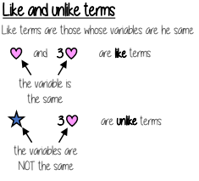
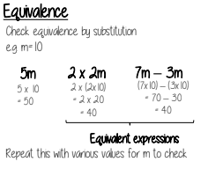
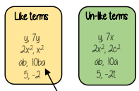
Maths: Equality and Equivalence
K
Key Terms
Key Concepts
Diagrams/Formula/Word Map
Equality: two expressions that have the same value
Equation: a mathematical statement that two things are equal
Equals: represented by ‘=‘ symbol – means the same
Solution: the set or value that satisfies the equation
Solve: to find the solution.
Inverse: the operation that undoes what was done by the previous operation. (The opposite operation)
Term: a single number or variable
Like: variables that are the same are ‘like’
Coefficient: a multiplicative factor in front of a variable e.g. 5x (5 is the coefficient, x is the variable)
Expression: a maths sentence with a minimum of two numbers and at least one math operation (no equals sign)
Resilience, Excellence, Respect

Slide 8
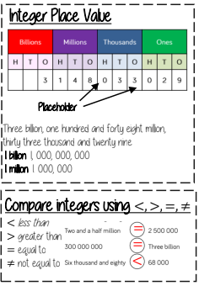
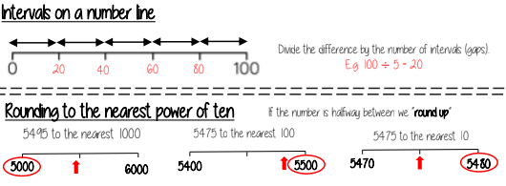
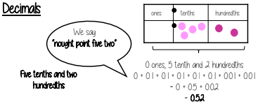
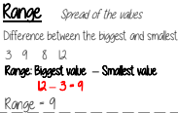
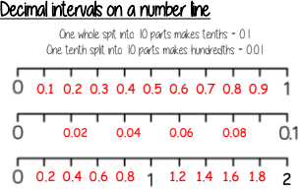
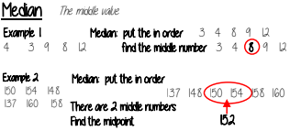
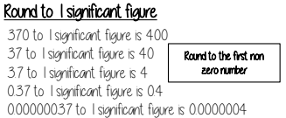
Maths: Integers and Decimals
K
Key Terms
Key Concepts
Diagrams/Formula/Word Map
Approximate: Estimate a number or total, often by rounding to simplify.
Integer: A whole number, positive or negative.
Interval: The gap or space between two values.
Median: Middle value in an ordered data set.
Negative: Any number less than zero, shown with a minus sign.
Placeholder: 0 used to show no value in a certain position.
Place value: A digit’s value depends on its position; each place is 10× the one to its right.
Range: Difference between the largest and smallest numbers in a set.
Significant figure: A digit that gives meaning to a number; first non-zero after a decimal or leftmost digit in an integer.
Resilience, Excellence, Respect

Slide 9
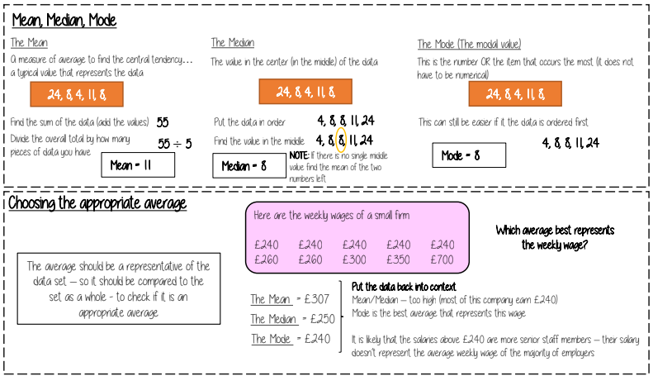
Maths: Measures of Location
K
Key Terms
Key Concepts
Spread: the distance/ how spread out/ variation of data
Average: a measure of central tendency – or the typical value of all the data together
Total: all the data added together
Frequency: the number of times the data values occur
Represent: something that shows the value of another
Outlier: a value that stands apart from the data set
Consistent: a set of data that is similar and doesn’t change very much
Resilience, Excellence, Respect

Slide 10
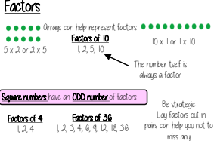
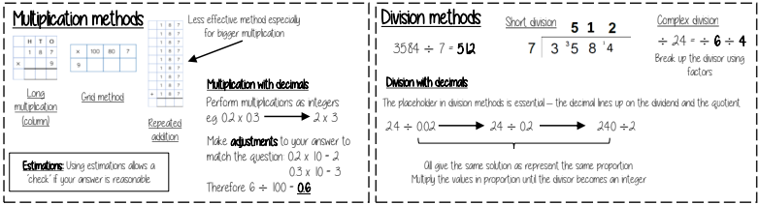
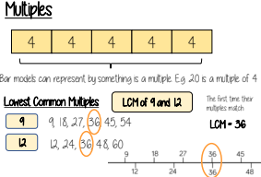

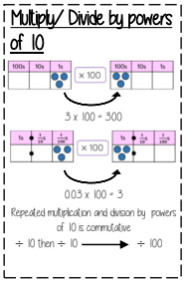
Maths: Multiplication and Division
K
Key Terms
Key Concepts
Diagrams/Formula/Word Map
Array: an arrangement of items to represent concepts in rows or columns
Multiples: found by multiplying any number by positive integers
Factor: integers that multiply together to get another number.
Mili: prefix meaning one thousandth
Centi: prefix meaning one hundredth.
Kilo: prefix meaning multiply by 1000
Quotient: the result of a division
Dividend: the number being divided
Divisor: the number we divide by.
Resilience, Excellence, Respect

Slide 11
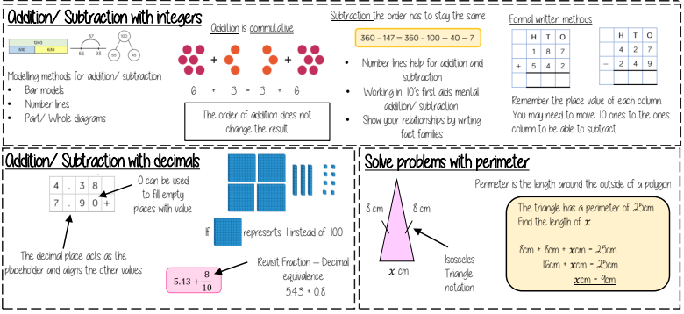
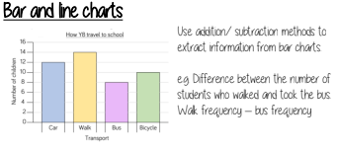
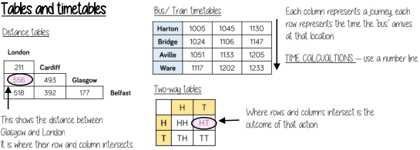
Maths: Addition and Subtraction
K
Key Terms
Key Concepts
Commutative: Order of numbers doesn’t change the result.
Associative: In addition/multiplication, grouping doesn’t affect the result.
Inverse: An operation that undoes another.
Placeholder: A number in position to show value.
Perimeter: Distance around a 2D shape.
Polygon: 2D shape with straight lines.
Balance: Money in a bank account.
Credit: Money going in.
Debit: Money going out.
Resilience, Excellence, Respect

Slide 12
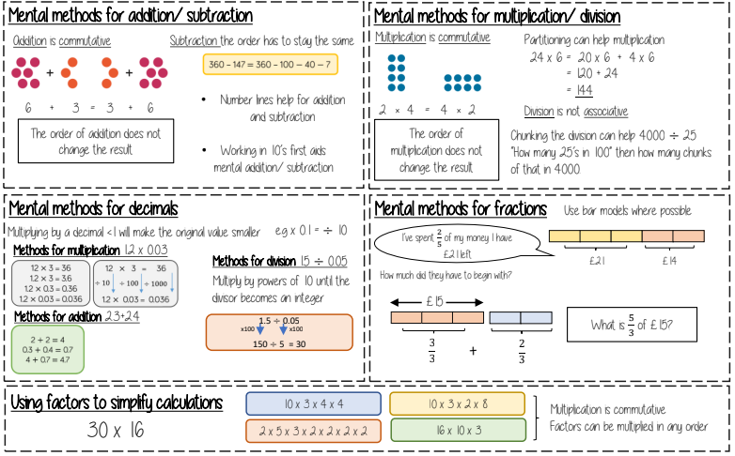
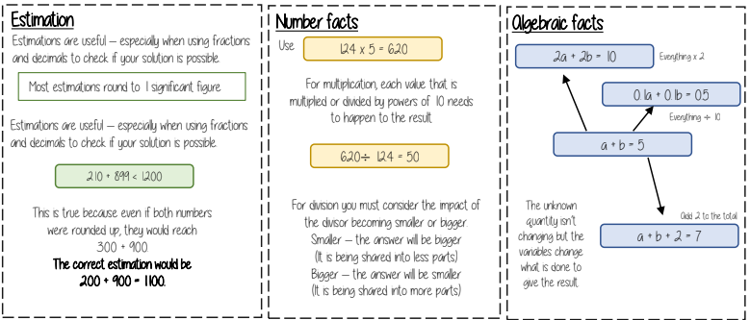
Maths: Number Sense
K
Key Terms
Key Concepts
Diagrams/Formula/Word Map
Commutative: changing the order of the operations does not change the result
Associative: when you add or multiply you can do so regardless of how the numbers are grouped
Dividend: the number being divided
Divisor: the number we divide by.
Expression: a maths sentence with a minimum of two numbers and at least one math operation
Equation: a mathematical statement that two things are equal
Quotient: the result of a division
Resilience, Excellence, Respect

Slide 13
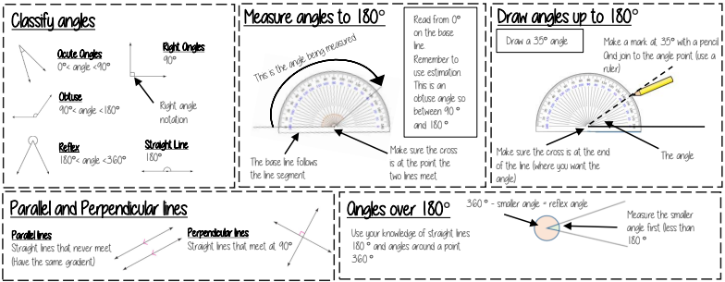
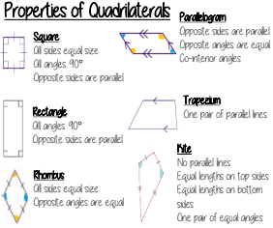
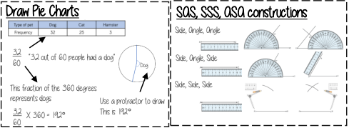
Maths: Angles
K
Key Terms
Key Concepts
Polygon: A 2D shape made with straight lines
Scalene triangle: a triangle with all different sides and angles
Isosceles triangle: a triangle with two angles the same size and two angles the same size
Right-angled triangle: a triangle with a right angle
Frequency: the number of times a data value occurs
Sector: part of a circle made by two radii touching the centre
Rotation: turn in a given direction
Protractor: equipment used to measure angles
Compass: equipment used to draw arcs and circles.
Resilience, Excellence, Respect

Slide 14
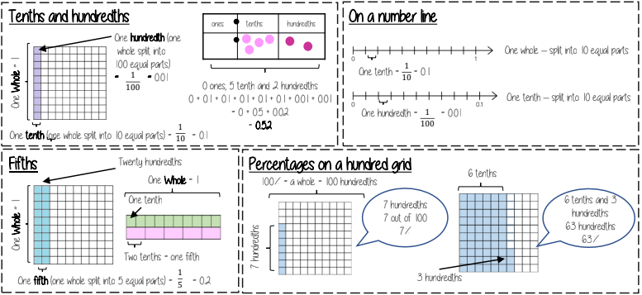


Maths: FDP Equivalence
K
Key Terms
Key Concepts
Fraction: how many parts of a whole we have
Decimal: a number with a decimal point used to separate ones, tenths, hundredths etc.
Percentage: a proportion of a whole represented as a number between 0 and 100
Place value: the numerical value that a digit has decided by its position in the number
Placeholder: a number that occupies a position to give value
Interval: a range between two numbers
Tenth: one whole split into 10 equal parts
Hundredth: one whole split into 100 equal parts
Sector: a part of a circle between two radius (often referred to as looking like a piece of pie)
Recurring: a decimal that repeats in a given pattern
Resilience, Excellence, Respect

Slide 15




Maths: Directed Numbers
K
Key Terms
Key Concepts
Diagrams/Formula/Word Map
Subtract: taking away one number from another.
Negative: a value less than zero.
Commutative: changing the order of the operations does not change the result
Product: multiply terms
Inverse: the opposite function
Square root: a square root of a number is a number when multiplied by itself gives the value (symbol )
Square: a term multiplied by itself.
Expression: a maths sentence with a minimum of two numbers and at least one math operation (no equals sign)
Resilience, Excellence, Respect

Slide 16




Maths: Percentages
K
Key Terms
Key Concepts
Fraction: how many parts of a whole we have
Equivalent: of equal value
Whole: a number with no fractional or decimal part.
Percentage: parts per 100 (uses the % symbol)
Place Value: the value of a digit depending on its place in a number. In our decimal number system, each place is 10 times bigger than the place to its right
Convert: change into an equivalent representation, often fraction to decimal to a percentage cycle.
Resilience, Excellence, Respect

Slide 17






Maths: Prime Numbers
K
Key Terms
Key Concepts
Diagrams/Formula/Word Map
Multiples: found by multiplying any number by positive integers
Factor: integers that multiply together to get another number.
Prime: an integer with only 2 factors.
Conjecture: a statement that might be true (based on reasoning) but is not proven.
Counterexample: a special type of example that disproves a statement.
Expression: a maths sentence with a minimum of two numbers and at least one math operation (no equals sign)
HCF: highest common factor (biggest factor two or more numbers share)
LCM: lowest common multiple (the first time the times table of two or more numbers match)
Resilience, Excellence, Respect

Slide 18



Maths: Indices
K
Key Terms
Key Concepts
Diagrams/Formula/Word Map
Base: The number that gets multiplied by a power
Power: The exponent – or the number that tells you how many times to use the number in multiplication
Exponent: The power – or the number that tells you how many times to use the number in multiplication
Indices: The power or the exponent.
Coefficient: The number used to multiply a variable
Simplify: To reduce a power to its lowest term
Product: Multiply
Resilience, Excellence, Respect

Slide 19





Maths: Fractional Thinking
K
Key Terms
Key Concepts
Numerator: the number above the line on a fraction. The top number. Represents how many parts are taken
Denominator: the number below the line on a fraction. The number represent the total number of parts
Equivalent: of equal value
Mixed numbers: a number with an integer and a proper fraction
Improper fractions: a fraction with a bigger numerator than denominator
Substitute: replace a variable with a numerical value
Place value: the value of a digit depending on its place in a number. In our decimal number system, each place is
10 times bigger than the place to its right
Resilience, Excellence, Respect

Slide 20



Subject: Shapes
K
Key Terms
Key Concepts
Diagrams/Formula/Word Map
Vertically Opposite: angles formed when two or more straight lines cross at a point.
Interior Angles: angles inside the shape
Sum: total, add all the interior angles together
Convex Quadrilateral: a four-sided polygon where every interior angle is less than 180°
Concave Quadrilateral: a four-sided polygon where one interior angle exceeds 180°
Polygon: A 2D shape made with straight lines
Scalene triangle: a triangle with all different sides and angles
Isosceles triangle: a triangle with two angles the same size and two angles the same size
Right-angled triangle: a triangle with a right angle
Resilience, Excellence, Respect

Slide 21






Maths: Rates
K
Key Terms
Key Concepts
Convert: change
Mass: a measure of how much matter is in an object. Commonly measured by weight.
Origin: the coordinate (0, 0)
Volume: the amount of 3D space a shape takes up
Substitute: putting numbers where letters are – replacing numbers into a formula
Diagrams/Formula/Word Map
Resilience, Excellence, Respect

Slide 22



Science: Introduction to Science
KS Line
Key Terms
Key Concepts
Diagrams/Formula/Word Map
Scientific method – Process of carrying out an investigation which isolates one variable to see its effect on another
Independent variable – The variable which you change
Dependent variable – the dependent which is measured
Control variable - variables which are kept the same
Conclusion – a written summary that describes the results using data
Bar chart = categorical data
Line graph – continuous data
Line of best fit – describes the pattern shown by a set of points
When you light the Bunsen burner, the flame will be yellow - this is often known as the ‘safety flame’ because you can see it.
The blue flame is used for heating. It is hotter because more air can flow through the Bunsen burner but it is harder to see.
Turning the collar of the Bunsen burner lets different amount of air in and changes the temperature of the flame.
Resilience, Excellence, Respect

Slide 23




Subject: Topic – Cells
KS Line
Key Terms
Key Concepts
Diagrams/Formula/Word Map
Nucleus - Contains genetic material and controls activities of the cell.
Cytoplasm - Gel-like substance where most of the chemical reactions happen
Cell membrane - controls what goes in and out
Mitochondria - where respiration takes place
Ribosome - where proteins are made
Cell wall - made of cellulose – supports and strengthen the cell
Vacuole - Contains cell sap
Chloroplast - Where photosynthesis occurs. Contains green substance called chlorophyll which absorbs light energy needed for photosynthesis
Specialised animal cells have components that allow them to complete a specific purpose.
Specialised animal cells include red blood cells, sperm, eggs, nerve cells, muscle cells, ciliated cells, and villi.
Resilience, Excellence, Respect

Slide 24








Subject: Topic – Particles & Separation
KS Line
Key Terms
Key Concepts
Diagrams/Formula/Word Map
Kinetic energy –The energy the particles possess due to motion
Melting point - The temperature at which a solid changes state from solid to a liquid
Boiling point - The temperature at which a liquid changes state to a gas
Evaporation – Change of state from liquid to gas
Condensation – change of state from gas to liquid
Resilience, Excellence, Respect

Slide 25



Subject: Topic – Forces & Space
KS Line
Key Terms
Key Concepts
Diagrams/Formula/Word Map
Force - Measured in Newtons, a push or a pull that affects the position of an object
Mass - The force acting on the object due to gravity. Measured in kg
Gravity - The force by which a planet or other body draws objects toward its centre.
Gravitational field strength - The strength of a gravitational field dependent on the gravitational pull of a planet or moon
Resultant force – overall force
Solar system - Consists of the planets, the sun and asteroids
A resultant force is the overall force acting on an object when all the individual forces are added together. If the forces are in the same direction, they are added. If the forces are in opposite directions, you subtract the smaller one from the bigger one.
My - Mercury
Very- Venus
Energetic- Earth
Mother- Mars
Just- Jupiter
Served- Saturn
Us- Uranus
Nandos- Neptune
Mass | Weight
The amount of matter in something | The force of gravity pulling on a mass
Always stays the same | Can change depending on where you are
Measured in kilograms (kg) | Measured in newtons (N)
Resilience, Excellence, Respect

Slide 26



Subject: Topic – Chemical Reactions
KS Line
Key Terms
Key Concepts
Diagrams/Formula/Word Map
Acid - Solution with a pH of 1-6 (red-yellow with Universal indicator)
Alkali - Solution with a pH of 8-14 (blue to purple with Universal indicator)
Neutral - Solution with a pH of 7(green with Universal indicator)
Malleable - A property of a substance meaning it can be bent and hammered into different shapes but not lose its other properties.
Brittle - A property of a substance meaning it will shatter when a force is applied to it.
Displacement - A chemical reaction that occurs when a more reactive metal replaces a less reactive metal in a compound.
Metals
People use lots of metallic elements in their everyday lives. These include elements like iron, copper, gold and silver. Most metals share similar properties with each other. For example:
They have high melting and boiling points meaning they are solid at room temperature
They are good conductors of heat and electricity
They are shiny in their appearance
They are malleable
Non Metals
Oxygen, carbon, sulfur and chlorine are examples of non-metal elements.
Non-metals have properties in common with each other. For example, they are often:
Poor conductors of heat and electricity
Dull in their appearance
Weak and brittle
Resilience, Excellence, Respect

Slide 27





Subject: Topic – Electricity
KS Line
Key Terms
Key Concepts
Diagrams/Formula/Word Map
Series circuit – forms a single loop
Parallel circuit – forms branches
Ammeter – in series. Measures current
Current - flow of charge/electrons
Potential difference – amount of energy per charge
Voltmeter – connected in parallel. Measures potential difference
Resistor – slows down current
Resistance – reduces flow of current . Measured in ohms
Diode – current flows in one direction
Resilience, Excellence, Respect

Slide 28




Subject: Topic – Variation & reproduction
KS Line
Key Terms
Key Concepts
Diagrams/Formula/Word Map
Egg – female sex cell
Fertilisation – fusing of male & female sex cells
Ovary – The female reproductive organ – produces eggs
Testes – male reproductive organ – produces sperm
Embryo – tiny new human life which grows cell by cell from a fertilised egg cell
Foetus – unborn baby from 8 weeks
Menstruation – monthly shedding of uterus lining if not pregnant
Placenta – organ allowing substances to pass between mother & baby’s blood
Resilience, Excellence, Respect

Slide 29

Subject: Topic – Nutrition & digestion
KS Line
Key Terms
Key Concepts
Diagrams/Formula/Word Map
Digestion – breakdown of large insoluble food molecules into small soluble ones
Digestive system – organ system involved in breaking down food so it can be absorbed
Amylase – enzyme which breaks down starch into simple sugars
Lipase – enzymes breaking down fats into fatty acids & glycerol
Protease – enzymes breaking down protein into amino acids
Carbohydrase – enzymes breaking down carbohydrates
Enzyme- protein which speeds up reactions
Understanding a Balanced Diet
"A diet that includes the right amounts of all the necessary nutrients (carbohydrates, proteins, fats, vitamins, minerals, fibre, and water) to maintain health and support the body’s needs."
Nutrient | Function | Example Foods
Carbohydrates | Provide energy for daily activities | Bread, pasta, rice, potatoes
Proteins | Growth and repair of cells and tissues | Meat, fish, eggs, beans, lentils
Fats | Energy source and insulation, cell structure | Butter, oils, nuts, cheese
Vitamins | Support body functions | Fruits, vegetables, dairy
Minerals | Help with body processes | Red meat (iron), milk (calcium), bananas (potassium)
Fibre | Aids digestion and prevents constipation | Wholegrain bread, cereals, vegetables
Water | Keeps the body hydrated. | Water, fruits, soups
Resilience, Excellence, Respect

Slide 30





Subject: Topic – Periodic table
KS Line
Key Terms
Key Concepts
Diagrams/Formula/Word Map
Periodic table – table of elements in order of atomic number
Group – vertical columns of periodic table
Period – horizontal rows of periodic table
Atom – smallest piece of an element
Element – substance containing only one type of atom
Compound – 2 or more elements chemically joined together
Mixture – 2 or more elements and/or compounds not chemically joined together
Chemical reaction – process where 1/more substances are changed into others
Resilience, Excellence, Respect

Slide 31




Subject: Topic – Waves
KS Line
Key Terms
Key Concepts
Diagrams/Formula/Word Map
Angle of incidence – angle between normal and incident ray
Angle of reflection – angle between reflected ray and normal
Diffuse scattering – when light is reflected off a surface in all directions
Frequency – number of waves per second (Hertz)
Amplitude – maximum height of a single wave from middle to peak or trough
Wavelength – length of a single wave
Pitch – frequency of sound
Echo – reflection of sound
Resilience, Excellence, Respect

Slide 32





Subject: Topic – Ecosystems
KS Line
Key Terms
Key Concepts
Diagrams/Formula/Word Map
Biodiversity: the variety of living organisms.
Ecosystem: the interaction between the living organisms and the different factors of the environment.
Community: made up of the populations of different species living in a habitat.
Competition: the negative interaction between two or more organisms which require the same limited resource.
Consumers: feed on other organisms for their energy. Can be primary, secondary or tertiary.
Resilience, Excellence, Respect

Slide 33


Subject: Topic – Energy stores
KS Line
Key Terms
Key Concepts
Diagrams/Formula/Word Map
Energy transfer – changes from one energy store to another
Conservation of energy – Energy cannot be created or destroyed, only transferred to another form
Kinetic energy – movement energy
Elastic potential energy – energy stored in squashed, stretched or twisted materials
Gravitational potential energy – energy stored in a raised object against gravity
Power – rate of work done
Non-renewable – a resource that cannot be replaced once used up
Energy Store | Description
Chemical Energy | Energy stored in fuels, food, and batteries. Released during chemical reactions.
Kinetic Energy | Energy stored in a moving object. Increases with speed and mass.
Gravitational Potential Energy | Energy stored in an object held at height. Increases with height and mass.
Elastic Potential Energy | Energy stored in a stretched or compressed object, like a spring or rubber band.
Thermal (Internal) Energy | Energy stored in an object due to the movement of its particles (linked to temperature).
Magnetic Energy | Energy stored when magnetic poles are pushed together or pulled apart.
Electrostatic Energy | Energy stored when like charges are close together or opposite charges are separated.
Nuclear Energy | Energy stored in the nucleus of atoms. Released during nuclear reactions.
Resilience, Excellence, Respect

Slide 34




Subject: Topic – Chemical reactions 2
KS Line
Key Terms
Key Concepts
Diagrams/Formula/Word Map
Endothermic – reactions which take in heat
Exothermic – reactions which give out heat
Oxidation – reactions of elements with oxygen
Combustion – burning fuel in oxygen
Thermal decomposition – to break a substance down using heat
Reactivity series – metals in order of reactivity
Displacement – a more reactive metal will displace a less reactive one from a compound
Catalyst – a substance that increases the rate of reaction without being used up
What is a combustion reaction?
Combustion is another word for burning. In a combustion reaction, a fuel is heated and it reacts with oxygen.
Exothermic reactions
Exothermic reactions are chemical reactions which release energy from the chemicals into the surroundings.
The fire triangle summarises the three things needed for combustion
Reactive metals
Other metals are very reactive, meaning they easily take part in chemical reactions
Endothermic reactions
Endothermic reactions absorb energy from the surroundings. This energy is usually absorbed as heat, so the surroundings get colder.
Resilience, Excellence, Respect

Slide 35



Introduction to school - Year 7
Key Vocabulary
Key Concepts
Diagrams
School network
Username
Password
Respectful Communication
Digital Footprint
Cyberbullying
Inappropriate contact
Inappropriate content
Presentation Tools
Learn how to use the school network and its software tools safely and effectively.
Understand how to create strong passwords and keep them private
Know how to stay safe online by
making smart choices and protecting your information.
Communicate politely and responsibly by email, on social media, in games, and
when commenting on others’ work
Recognise and report anything online
that is inappropriate or makes you feel uncomfortable.
Understand what cyberbullying is, how to prevent it, and how to get help if it happens.
Use presentation tools well—respect copyright, think about accessibility, and
use good layout and design.
Resilience, Excellence, Respect

Slide 36

Using media to gain support for a cause - Year 7
Key Vocabulary
Key Concepts
Diagrams
Blog
Microblog
Copyright
Licensing
Source
Credibility
Plagiarism
Reference
Self- Evaluation
Describe the features of a blog and how they can be consistently formatted.
Select appropriate images whilst ensuring I comply with copyright and licensing restrictions.
Evaluate the credibility of online sources to help me with my own work.
Research and use content ethically to avoid plagiarism.
Create a blog that uses success criteria and self-evaluation to support the writing.
Create a microblog post and use a rubric to assess the quality of my blog post.
Resilience, Excellence, Respect

Slide 37





Computer Networks - Year 7
Key Vocabulary
Key Concepts
Diagrams
Computer Network: When two or more computers are connected together to allow them to communicate
Protocols: A set of rules to allow communication between computers
Web Browser: A piece of software
used to view information on the World Wide Web
World Wide Web: Service provided on the Internet
Internet: A vast network of computers all connected together
Bandwidth: The amount of data that can be moved from one point to another in a given time
Bandwidth
Computer Network
Internet
IP Address
Network Hardware
Packets
Protocols
World Wide Web
Server
Resilience, Excellence, Respect

Slide 38
Spreadsheets - Year 7
Key Vocabulary
Key Concepts
Diagrams
Cell Reference
Cells
Columns
Data
Formula
Information
Primary Source
Rows
Secondary Source
Cell Reference (i.e. B7 or A1) is the location of a cell
All formulas start with an = sign, =SUM(A1,A2)
SUM: Adds the numbers in the specific cell range
MAX: Finds the largest value in a data set
MIN: Finds the smallest value in a data set
COUNTA: Finds the number of non-empty cells
AVERAGE: Finds the average of all selected values
COUNTIF: Used to find how many of a specified piece of data there are i.e. How many athletes won 3 Gold Medals or more
Resilience, Excellence, Respect

Slide 39

Computational Thinking
K
Key Vocabulary
Key Concepts
Flowchart Guide
Abstraction
Algorithm
Arrow
Decision
Decomposition
Flowchart
Input / Output
Pattern Recognition
Process
Variables
Decomposition: Breaking down a large or complex problem into smaller, more manageable parts and are easier to understand
Abstraction: Removing unnecessary details and focusing on what’s important
Pattern Recognition: Looking for similarities and trends
Algorithm Design: A sequence of instructions to help solve a problem or carry out a task
Debugging: The process of identifying and fixing errors
Process/Task
Start/Stop
Decision
Arrow
Input/Output
Flowchart: Visual way to represent list of instructions
Start/Stop: Highlights the beginning and end of a flowchart
Process/Task: An action, something you do, i.e. brush your teeth
Input/Output: Input is something a user puts into a system and an output is something the system displays to the user.
Decision: A Yes or No question, you follow a path based on your answer
Arrows: Shows the direction of flow in a flowchart
Resilience, Excellence, Respect

Slide 40






Scratch (Programming)- Year 7
Key Vocabulary
Key Concepts
Diagrams
Blocks
Debugging
Event Block
Loop
If Statement
Sequence
Sprite
Variable
Sequences: Code runs in order you place the blocks, one after the other
Selection (If Statements): Making a decision in a program. If a condition is true, the code inside the if block runs
Variables: A way to store information that can change, such as a score or a timer
Backdrop: The background of your project
Sprites: The characters you create
Events Block: Starts the code when something happens, e.g. green flag clicked or key pressed)
Motion Blocks: Controls the movement or your sprites
Resilience, Excellence, Respect

Slide 41













Spanish Year 7 Half Term 1 Mi Vida
K
Key Vocabulary
Key Concepts
Grammar & Phonics
¿Tienes hermanos?
Do you have siblings?
Verbs
Articles
Adjective Agreement
Resilience, Excellence, Respect

Slide 42







Spanish Year 7 Half Term 1 Mi Vida
K
Key Vocabulary
Key Concepts
Grammar & Phonics
Connectives
In Spanish we use the verb tener (to have) to talk about our age!
Alphabet
Phonics
And | Y
But | Pero
Also | También
However | Sin embargo
In addition/Moreover | Además
Numbers
Intensifiers
Quite | Bastante
Very | Muy
A litte | Un poco
Too | Demasiado
Introductions
Creo que…I believe that
En mi opinión…In my opinion
Complex opinions
¿Dónde vives? | Where do you live?
Vivo en… | I live in
¿Cómo te llamas? | What is your name?
¿Qué tal? ¿Como estás? | How are you?
Muy bien, ¿y tú? | Very good, and you?
Diría que…I would say that
Pienso que…I think that
Me parace que…It seems to me that
Resilience, Excellence, Respect

Slide 43









Spanish Year 7 Half term 2 Mi Tiempo Libre
K
Key Vocabulary
Key Concepts
Grammar & Phonics
¿Cuándo es tu cumpleaños?
When is your birthday?
Questions?
Mi cumpleaños es el (día) de (mes).
My birthday is the (day) of (month).
Porque | Because
It is | Es
Grammar
Días de la semana
Days of the week
Adjectives
I love
I am fascinated by
I really like
I like
I don’t mind
I don’t like
I don’t like at all
I hate
Resilience, Excellence, Respect

Slide 44








Spanish Year 7 Half term 2 Mi Tiempo Libre
K
Key Vocabulary
Key Concepts
Grammar & Phonics
Los deportes -Sports
El presente – the present tense
Juego | I play
Hago | I do
The present tense is used to describe what something is like, what is happening now or what we do regularly.
To form the present tense: remove the –ar, -er, -ir from the verb and add the endings:
I like to surf the internet
I like to chat
I like to listen to music
I like to play videogames
I like to send texts
I like to watch TV
Frequency adverbs
Qué tiempo hace? What is the weather like?
Siempre | Always
Todos los días | Every day
De vez en cuando | From time to time
Normalmente | Normally
Nunca | Never
Casi nunca | Almost never
A veces | Sometimes
I like to read
I like to write emails
I like to go out with my friends.
Irregular verb
It’s hot
¿Qué te gusta hacer? What do you like to do?
It’s cold
It’s sunny
Opinion phrase + infinive verb + because it is + adjective
Me gusta escuchar música porque es divertida.
Regla: After an opinion phrase the verb (the action)must end in –ar, -er or -ir
It’s good weather
It rains
It snows
Resilience, Excellence, Respect

Slide 45










Spanish Year 7 Half term 3 Mi insti
K
Key Vocabulary
Key Concepts
Grammar & Phonics
Las asignaturas -Subjects
Verbs
Example:
Me gusta la música porque es divertida.
Opinion phrase
Singular = el/la
Plural = los/las
Subject
La = singular + feminine
Porque es = singular opinion phrase
Divertida = feminine adjective
(la música)
Resilience, Excellence, Respect

Slide 46





Spanish Year 7 Half term 3 Mi insti
K
Key Vocabulary
Key Concepts
Grammar & Phonics
En mi insti hay | In my school there is/are…
En mi insti no hay | In my school there is/are no…
Un/una | A
Unos/unas | Some
Muchos/muchas | Many
Mi profesor/a de___es__ | My teacher of__is____
¿Cuál es tu día favorito y por qué?
Which is your favourite day and why?
Mi día favorito es el (lunes) porque estudio (las ciencias y el dibujo)
My favoruite day is (day of the week) because I study (subject)
¿Qué hay en tu insti?
What is there in your school?
En mi insti (no) hay + noun + intensifier+ adjective.
En mi insti hay una biblioteca bastante grande.
Regla - rule
In Spanish the adjective always comes after the noun. Ejemplo: a modern classroom = una clase moderna.
¿Cómo es tu profesor/a?
What is your teacher like?
My teacher of (subject) is (intensifier) +(adjective)
Mi profesor de geografía es muy interesante.
Resilience, Excellence, Respect

Slide 47






Spanish Year 7 Half term 4 Mi familia y mis amigos
K
Key Vocabulary
Key Concepts
Grammar & Phonics
Me llamo | My name is…
Se llama | His/her name is…
Tengo el pelo… Tengo el pelo rubio y largo. | I have ____ hair. I have long blond hair.
Tengo los ojos… Tengo los ojos marrones. | I have ____ eyes. I have brown eyes.
Possessive Adjectives
Verbs
¿Cuántas personas hay en tu familia?
How many people are there in your family?
En mi familia hay … personas. Mi … se llama… y tiene … años.
In my family there are … people.
My …. is called …. and he/she is …. years old.
Resilience, Excellence, Respect

Slide 48






Spanish Year 7 Half term 4 Mi familia y mis amigos
K
Key Vocabulary
Key Concepts
Grammar & Phonics
The colour of the eye is plural.
Los ojos azules = The blue eyes.
Soy | I am
Tengo | I have
Llevo | I wear
Resilience, Excellence, Respect

Slide 49











Spanish Year 7 Half Term 5 Mi Ciudad
K
Key Vocabulary
Key Concepts
Grammar & Phonics
Mi casa está en el campo = My house is in the countryside.
Tu casa está en un pueblo = Your house is in a village.
Big
Small
Spacious
Comfortable
Nuestra casa está en la montaña = Our house is in the mountain.
Old
New
Modern
There are two ways to say it is:
Mi casa está (location). Mi casa es (description).
Mi casa está en la ciudad = My house is in the city.
Partes de la casa Parts of the house
Su casa está en la costa = His/her house is in the city.
Su casa está en el desierto = His/her house is in the desert.
Resilience, Excellence, Respect

Slide 50






Spanish Year 7 Half Term 5 Mi Ciudad
K
Key Vocabulary
Key Concepts
Grammar & Phonics
¿Qué hay en tu ciudad?
What is there in your city?
To the..:
A + EL = AL (Masculine)
A + LA = A LA (Feminine)
Ejemplo:
I go to the park: Instead of voy a el parque 🡪Voy al parque.
To describe what there is in your city:
In my city there is/are + place + intensifier + adjective
En mi ciudad hay un castillo bastante antiguo.
Impresionante | Impressive
Feo | Ugly
Bonito | Nice/pretty
Connectives
Y-and
También-also
Además- besides/ in addition
Sin embargo- however
Pero- but
Porque- because
Intensifiers
Bastante: quite
Muy: very
Un poco – a little
Extremadamente – extremely
Demasiado - too
¿Qué hora es?What is the time?
Hay | There is/are
No hay | There is not
Resilience, Excellence, Respect

Slide 51
History Year 7 Half Term 1 Romans
K
Key Vocabulary
Key Features
Key individuals and Events
Primary Source – Something which was produced at the time of an event and gives us information about the time; For example a skeleton of a Roman legionary.
Secondary Source – A source of information about an event which was created AFTER the event had already happened.
Chronology – The science of arranging events in the correct order in which they happened in history.
Republic – A nation which does not have a king, but is run by the people.
Empire – A powerful nation which rules over others, usually by conquering them.
Emperor/Empress – The ruler of an empire
Temple – The place where the Romans worshipped their Pantheon (multiple gods).
Amphitheatre – An outdoor arena for watching sports and people give speeches
Aqueduct – A building which carries water from one place to another.
Baths – Public places where Romans could wash.
Romans – The people of the city of Rome; They conquered many parts of Europe, Asia, and Africa. Many of the people in the Roman empire saw themselves as ‘Romans’ even thought they had never seen the city of Rome.
Celts – A tribal people who lived across Europe who were slowly conquered by the Romans.
Gauls – Celts that lived mostly in what is now France; They were conquered by the Romans and many become Roman citizens.
Britons – Like the Gauls, Britons were Celtic people who lived in the British isles and were eventually conquered by the Romans,
Iceni – A tribe of Britons that lived in East Anglia
Camulodunum – The Roman name for Colchester. The Romans captured Camulodunum from the Celts and made it their capital in Britain, although this only lasted 17 years when it was replaced by Londinum (London).
Legion – A unit of the Roman army, made up of 5000 men.
Legionary – The name for a Roman soldier in a Roman legion
Julius Caesar – A general in the Roman army who conquered Gaul for the Roman republic. He then started a Roman civil war and won, becoming dictator but was assassinated.
Augustus – The first emperor of the Romans, Augustus was a name that the emperor gave himself meaning ‘the great’. His real name was Octavian and he was the nephew of Julius Caesar.
Claudius – Emperor of the Roman empire when it conquered Britain in 43AD
Prasutagus – The ruler of the Iceni tribe.
Boudicca – The wife of Prasutagus and leader of the Iceni after his death.
Invasion of Britain – The Roman empire invaded Britain twice; Once in 55BC, led by Julius Caesar and the second time in AD 43 when the emperor Claudius ruled Rome.
Boudicca’s revolt – Boudicca led an uprising against Roman rule after the death of her husband because the Romans went back on their promise to let her rule half of her husbands kingdom when he died.
The destruction of Camulodunum – Boudicca destroyed Colchester burning the temple down with the town’s inhabitants inside.
Battle of Watling Street – A battle between a huge army of roughly 180,000 Celtic Britons led by Boudicca against an army of 10,000 Roman legionaries.
Resilience, Excellence, Respect

Slide 52
History Year 7 Half Term 2 The Normans
K
Key Vocabulary
Key Features
Key Individuals and Events
Heir- Next person in line to be king or queen
Crisis- A situation which is extremely difficult or dangerous
Witan- The group of men who decided the next king of England
Norman- Someone who came from Normandy in the 11th century
Saxon- Someone from England in the 11th century
Rebellion- To take up weapons against the king or government
False Retreat- To pretend to run away during a battle
Shield wall- Saxon technique of placing shields one next to the other to form a protective wall
Anglo-Saxons- People who came from England
Vikings- People who came from Norway
Order of succession- To decide who is in line to the throne
Battle of Stamford Bridge- Battle between the Vikings and Saxons
Battle of Hastings- Battle between the Saxons and the Normans
Catholicism- The religion in England in the 11th century, a type of christianity
Pitched battles- Battle which take place on a set day, at a set time.
The doomsday book- Something which William the conqueror used to record wealth and taxation in England
Succession crisis- In 1066 the king died with no children, causing a succession crisis
Edward the Confessor- King of England who died in Jan 1066, with no children
Harold Godwinson- Saxon claimant to the throne, chosen to be king by the Witan
Harald Hardrada- Viking claimant to the throne
William Duke of Normandy- Norman claimant to the throne
The Battle of Stamford Bridge- September 1066, the Saxons beat the Vikings in Battle
The Battle of Hasting- October 1066, The Normans beat the Saxons
The Harrying of the North- 1069-1070 William the Conqueror treated the North of England cruelly due to there being many rebellions there.
The Domesday survey- Completed in 1086, it was a list of the wealth of all households, to help provide tax information for the king.
Resilience, Excellence, Respect

Slide 53
History Year 7 Half Term 3 The Crusades
K
Key Vocabulary
Key Features
Key individuals and Events
Primary Source – Something which was produced at the time of an event and gives us information about the time; For example a skeleton of a Roman legionary.
Secondary Source – A source of information about an event which was created AFTER the event had already happened..
Chronology – The science of arranging events in the correct order in which they happened in history
Heaven – Believed by Christians to be where good people go after death.
Purgatory – The waiting room for heaven. People who have committed small sins are believed to go to purgatory to make up for their misdeeds until they can go to heaven.
Hell – Believed by Christians to be where people that have committed sinful acts go after death.
Pilgrimage – A journey to a religious place to show devotion to God.
Indulgence – A fast-track pass to heaven
Christianity – A religion which centres on the belief that Jesus was the son of God and sacrificed himself for the sins of humanity.
Islam – A religion which centres on the belief that Muhammad was the last messenger of Allah, who was given the rules on how to live.
Constantinople – The capital of the Byzantine empire (modern day Istanbul). The Byzantine emperor requested help retaking the Holy Land for Christianity from the Islamic Seljuk empire and the Pope sent European Christian warriors to help.
Crusade – A war between Christians and Muslims in the middle ages. The Christians from Europe wanted to take the Holy Land back from Muslim control.
Holy Land – An area in the middle east in which the events of the Bible take place. It is sacred to Jews, Christians, and Muslims.
Jerusalem – The holiest city on Earth, it is sacred to Jews, Christians, and Muslims.
Christians value Jerusalem because it is the place where Jesus was crucified to death and they believe he then rose from the dead – proving he was the son of God.
Crucifixion – A method of execution used by the Romans for those they saw as the lowest of the low. The victim is tied to a post or a cross and left to die in the sun.
Their hands and feet are nailed to the post so it is a slow, agonising death.
Pope – The Pope was/is the head of the Catholic church. During the middle ages (when the Crusades happened), the Pope was seen as God’s representative on Earth and therefore most European Christians listened to what he had to say.
First Crusade – A war in which the European Christian kingdoms united to retake the Holy Land from Islamic rule.
Third Crusade – Known as the King’s Crusade because of the three kings that went on it. It aimed to retake Jerusalem from the Muslims who had taken it back from the Christians after the First Crusade.
Richard I – Also known as Richard the Lionheart (Coeur de Lion), he was king of England and went on the Third Crusade but made lots enemies while he was there.
Phillip II – King of France, Phillip angered Richard I by returning home from the Third Crusade early.
Frederick Barbarossa – Known as Frederick the Redbeard, he was the Holy Roman emperor. He drowned crossing a river while on his way to the Holy Land for the Third Crusade.
Resilience, Excellence, Respect

Slide 54
History Year 7 Half Term 4 Power of Medieval Kings
K
Key Vocabulary
Key Features
Key individuals and Events
Monastery- A building where monks lived
Monk- Someone who devoted their life to the Catholic church
Archbishop of Canterbury- The highest job in the church in England
Magna Carta- The Great Charter, a document which limited the power of the king.
Baron- A member of the English nobility, they owned significant amounts of land, they swore loyalty to the king
Peasant- a poor medieval person, usually did farmwork
England was still a CATHOLIC country during the medieval period
During this period the King of England was a subject of the Pope- this means even the king must do as the Pope (and the church) said.
Priests within the church had separate laws to ordinary people- this was called “canon law”
The king was able to raise taxes when he wanted at the start of the medieval period. This would change by the end of the period.
Kings inherited their position from their father, you did not become king by showing how strong/fair/just you were.
Henry II- King of England who was accused of murdering Thomas Beckett
Thomas Beckett- The Archbishop of Canterbury
King Richard- Richard the Lionheart, elder brother of King John.
King John- King of England who was forced to sign the Magna Carta
The murder of Thomas Beckett- took place at canterbury cathedral in 1170
The signing of the Magna Carta- 1215
Resilience, Excellence, Respect

Slide 55
History Year 7 Half Term 5 Peasants Revolt
K
Key Vocabulary
Key Features
Key Individuals and Events
Revolt - violent protest
Protest - group of people sharing their dislike over something
Riot - violent method of protest
Peasant - 90% of population, farmers, blacksmiths, carpenters, bottom of the feudal system
Feudal System - hierarchy of social class (King, barons, knights, peasants)
Black Death - pandemic which spread across Europe, spread by fleas on rats
Poll Tax - Tax demanded by King Richard II to pay for wars
Buboes - boils of skin, symptom of black death
Miasma - belief that bad air causes disease in 1250-1500
Astrology - alignment of stars and planets (believed to be a cause of disease)
Flagellants - People who would whip themselves to show they were sorry for their sins, seen as a prevention to disease
The Black Death arrived in England in 1348. It had previously spread all across mainland Europe.
We now know that the black death was caused by fleas on the back of rats. People during medieval times did not understand this and thought the following caused the disease:
God’s punishment
Miasma - bad air
Jews poisoning wells
Astrology - alignment of stars and planets
Poor state of the Body
Richard II- 10 year old King
Wat Tyler - ex soldier, leader of the peasants
John Ball - priest who preached equality
Archbishop of Canterbury - 2nd most important religious figure in England (after the Pope)
Wise Women - in every village, free, herbal remedies
Apothecary - cheap and accessible, herbal remedies
Quack Doctor - fake doctor, lies about qualifications to make money
Barber Surgeon - barber, would conduct bloodletting and surgeries
Resilience, Excellence, Respect
Notes:
EWI

Slide 56
History Year 7 Half Term 6 Asian Empires
K
Key Vocabulary
Key Features
Key Individuals and Events
Allah - God
Muslim - Muhammad’s followers
Islam - name of the religion of people who are Muslim and follow the prophet Muhammad
Qur’an - book of Muhammad’s revelations from God (similar to the Bible)
Caliph - Leader of the Islamic Empire, Emperor
Caliphate - Caliphs reign, or area they controlled
Mosque - Muslim place of worship
Astrolabe - instrument used to tell time and determine direction
Makkah (Mecca) - city where Muhammad was born, place of pilgrimage for Muslims still today
Baghdad - Capital city of the Abbasid Empire, ‘Round City’
Tigris River - River which surrounded Baghdad, helped trade routes become established
Silk Roads- 5,000 miles of trade routes from China to Turkey, religion, objects, ideas and diseases spread
House of wisdom - research library in Baghdad where Muslim and non muslim scholars would develop ideas
Prophet Muhammad- Individual who was said to have started the Islamic religion. Taught his followers to worship Allah. Had visions and revelations from Allah.
Rashidun Caliphate - era of time from 632-661 when the Rashidun controlled the Islamic World
Umayyad Caliphate - era of time from 661-750 when the Umayyads controlled the Islamic world
Abbasid Caliphate - era of time from 750 when the Abbasids controlled the Islamic Empire
Golden age - time of learning and development in science, maths, art and literature
Mariam Astrulabi - created the astrolabe and helped develop modern navigation
Al-Kindi - doctor and world’s first code breaker
Al-Khwarizmi - mapmaker and mathematician, created algebra
Resilience, Excellence, Respect
Notes:
EWI

Slide 57



Geography Year 7 - Fieldwork
K
Key Vocabulary
Key Concepts
Diagrams/Formula/Word Map
Primary Data | Data you collect yourself
Secondary Data | Data collected by someone else
Enquiry Question | What you are investigating
Data Collection | Going out to collect data
Data Analysis | What your data shows
Conclusion | The answer to your original question
Evaluation | What went well and what could be improved next time?
Resilience, Excellence, Respect

Slide 58



Geography Year 7 – Map Skills
K
Key Vocabulary
Key Concepts
Diagrams/Formula/Word Map
Compass | A tool used to measure direction
Contour Lines | Lines that join up areas of equal height on a map
Line of Latitude | Lines which are drawn parallel around the globe
Lines of Longitude | Lines which connect the north and south poles
Four Figure | Four numbers that locate a square on a map
Six Figure | Six numbers that accurately locate a place on a map
Spot Height | A black dot on a map that tells you how high an exact point is
What are map symbols?
Maps contain a lot of information about the areas of land that they show. There are too many features to label everything using text, so we use map symbols.
Map symbols can include letters, coloured areas, pictures or lines. These symbols can be used to show the location of different features such as roads, viewpoints, bus stations, train stations, schools and post offices.
Have a look at this slideshow to see examples of map symbols used on Ordnance Survey (OS) maps.
Resilience, Excellence, Respect

Slide 59


Geography Year 7 - Settlement
K
Key Terms
Key Concepts
Diagrams/Formula/Word Map
Settlement | A place where people live
Site | The location of a settlement and characteristics of the land it is built on
Situation | The location of a settlement in relation to surrounding features like rivers, roads, or other settlements.
Urban | An area that is developed and built-up, like a town or city.
Rural | An area in the countryside
Function | The main purpose or activity of a settlement.
Site location factor
A physical or natural feature of the land that influences where a settlement is first established, such as access to water, flat land, fertile soil, or natural defence.
What makes a settlement?
Settlements are places where people live and sometimes work. They can be small or large.
This depends on how many people live there and how many facilities there are.
Resilience, Excellence, Respect

Slide 60




Geography Year 7 – Africa
K
Key Vocabulary
Key Concepts
Diagrams/Formula/Word Map
Continent – A large area of land made up of many countries (e.g. Africa, Europe).
Urbanisation – When more people move to live in towns and cities.
Infrastructure – The basic things a place needs: roads, electricity and water pipes.
Population distribution – How people are spread within a country or area.
Misconception – A wrong idea or belief about something.
Africa is a diverse continent with 54 countries. It has deserts like the Sahara, rivers like the Nile, and cities like Nairobi. Urbanisation bings jobs and new challenges to the continent. Misconceptions about Africa are also common. There is a potentially bright future for Africa, with examples such as solar panels in Kenya, which is helping more people to access electricity.
Resilience, Excellence, Respect

Slide 61




Geography Year 7 – Asia
K
Key Vocabulary
Key Concepts
Diagrams/Formula/Word Map
Choropleth map – A map that uses different colours or shades to show data, like population.
Climate zones – Areas of the world with similar weather e.g. hot and dry or cold and wet.
Monsoon – A strong seasonal wind that brings heavy rain to places like India.
Overpopulation – When too many people live in one place for the resources available.
Air pollution – When harmful gases or smoke make the air dirty and unsafe to breathe.
Asia is the largest continent, including countries such as China and India within it. Physical features include deserts, rivers, and the Himalayas. It has different climates such as monsoons.
Some areas face problems such as too many people or air pollution. Solutions include renewable energy and planning for growth.
Resilience, Excellence, Respect

Slide 62















Geography Year 7 – Weather
K
Key Vocabulary
Key Concepts
Diagrams/Formula/Word Map
Forecast – A prediction of what the weather will be like in the next few days.
Temperature – How hot or cold it is.
Precipitation – Water falling from the sky, like rain, snow, or hail.
Wind speed – How fast the wind is blowing.
Air pressure – The weight of the air pressing down on Earth.
Tropical storm – A powerful storm with heavy rain and strong winds.
Extreme weather – Very unusual or dangerous weather, like floods, heatwaves, or big storms.
Weather is the day-to-day state of the atmosphere. Climate is the average weather over time. We measure weather using satellites and forecasts. The UK and the world have different weather types, including extreme events. An example of extreme weather is blizzards and we look at this in further detail with the ‘Beast from the East’.
Resilience, Excellence, Respect

Slide 63







Year 7 Art
K
Key Vocabulary
Key Artists
Key Techniques / Materials
Presentation = work presented thoughtfully and with pride
Lines = Line is the most basic visual element. Lines can be used to define shapes and figures, but also to indicate motion, emotion, and other elements
Texture = In a two-dimensional work of art, texture gives a visual sense of how an object depicted would feel in real life if touched
Imaginative = the mental faculty of forming new images that are not present to the senses, creating original work
Colour theory = Colour theory includes the colour wheel, colour value, and colour schemes
Mobile = a type of sculpture that is formed components which are suspended in the air
Jon Carling
Sara
Fanelli
Henri
Matisse
Alexander
Calder
Mark Making = Mark making describes the way artists produce different lines, dots, marks, patterns and textures
Collage = Collage describes the technique and the resulting work of art in which pieces of paper are arranged and stuck down
Abstract Compositions = Absence of recognizable objects,use of Shapes, Colors, Lines and Textures instead
Resilience, Excellence, Respect

Slide 64






Year 7 Visual Communication
K
Key Vocabulary
Key Artists
Key Ideas
GRAPHICS = the art of composing visual elements such as typography, images, coloUrs, and shapes, to communicate information or convey a message effectively.
DESIGN BRIEF = is a short description of key elements of your project
PHOTOGRAPHY = is the art and science of capturing images using light and a camera.
RULES OF COMPOSITION = is the type of arrangement of all the elements that make up the scene in a photograph.
ROBERT
INDIANNA
ROY LIECHTENSTEIN
PETER
BLAKE
LOGO = a symbol or other small design adopted by an organization to identify its products, uniform, vehicles, etc.
TYPOGRAPHY = is the art and technique of arranging type to make written language legible, readable, and appealing when displayed.
RULE OF SYMMETRY = In photography symmetry appears when parts of your composition mirror other parts.
Resilience, Excellence, Respect

Slide 65







Year 7 Food Technology
K
Key Vocabulary
Key Skills
Key Ideas
NUTRIENTS = Macronutrients & micronutrients. Protein, fats, carbohydrates.
HYGIENE = Hazards, cross- contamination.
SENSES = Touch, taste, smell
ALLERGIES= foods that are dangerous to certain individuals causing their bodies to react
HEALTHY DIET= Gives you the right amount of energy to grow well and have a healthy body.
HYGIENE & CROSS CONTAMINATION =
Using the correct colour of chopping board
ALLERGENS= Different from intolerance or not liking a food as they can be dangerous
FOOD PREPARATION = Cooking can include cutting and heating different foods. Preparing, cooking and cleaning the kitchen space so that food is made safely.
SEASONALITY= Foods grow and ripen at different times.
KNIFE SKILLS = bridge and claw hold.
CLEANING SKILLS= prevention of harm through cross contamination.
COOKING SKILLS= Develop ability to make simple dishes safely
Resilience, Excellence, Respect

Slide 66




Year 7 3D Design
K
Key Vocabulary
Key Skills
Key Ideas
Design Brief:- Setting of the task including several “Must have” elements by which to measure the success of your outcome.
Testing:- Ensuring that your product performs to the level intended
Evaluation:- Assessing your product against the original design brief
Analysis:- Looking into the design task and investigating the wants, needs, desires and limitations of the customer requirements
Development:- Taking an idea and making it better through testing and alteration until it performs as desired.
Marking out
Measuring
Fabricating
Finishing
Looking closely:- Identifying a problem or need and using subject/material knowledge, finding a solution.
Choosing:- Finding a task that needs to be completed and then selecting the correct tool and process to employ enabling the successful completion of the task
Learning:- what tools are used and how they are held/used/employed to perform the desired outcome
Measuring:- marking out pieces for construction or even the joints accurately
Competent:- Ability to use tools accurately adding to the quality of finish of their products.
Finishing skills:- Learning to sand/finish, apply paint/varnish adding to the quality of finis
Resilience, Excellence, Respect

Slide 67

Music: Introduction To Notation
Resilience, Excellence, Respect

Slide 68

Music : Orchestra instruments
Resilience, Excellence, Respect

Slide 69

Music: Motown
Resilience, Excellence, Respect

Slide 70

Drama: Drama Island
Resilience, Excellence, Respect

Slide 71

Drama: Storytelling & Script work
Resilience, Excellence, Respect

Slide 72

Drama: Drakwood Manor
Resilience, Excellence, Respect

